Slide 1



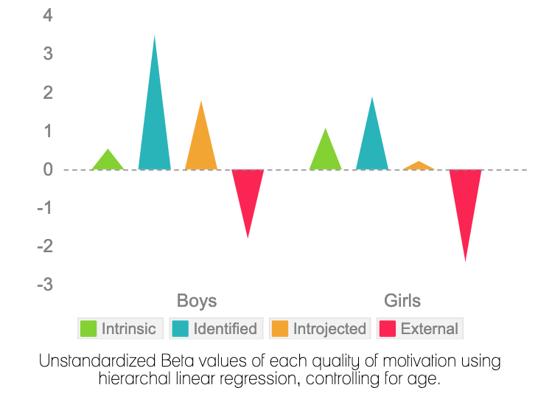
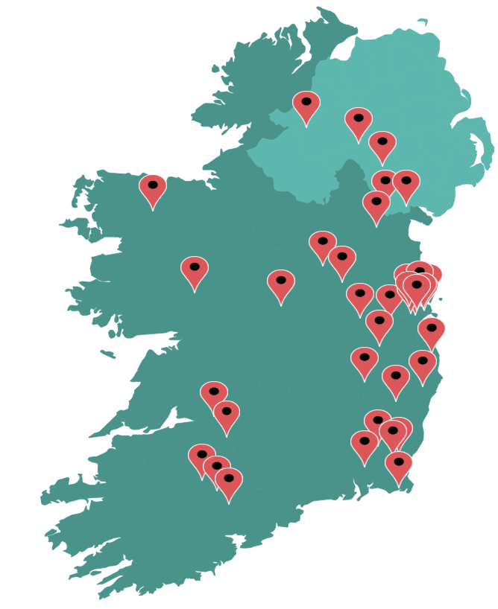










The Moving Well-Being Well Project:
Exploring components of Physical Literacy in Irish children
Cameron Peers, Dr. Sarahjane Belton, Stephen Behan, Prof. Noel O’Connor, Dr. Johann Issartel
Children’s physical literacy journey does not necessarily progress in a strictly linear manner, but rather the focus should be on the relationship and the development that exists among the constructs of physical literacy.
It is important to empirically understand how the constructs are connecting to develop a physically literate individual
860 children assessed across 30 schools (47.7% female, 10.9 ± 1.16 years)
The TGMD-3 ( Ulrich, 2017) was implemented to evaluate FMS. With the pictorial scale of PMSC for young children administered to align (Barnett et al., 2015)
Quality of motivation was measured using the BREQ adapted, meanwhile physical self efficacy was measured using the 8-item PASES (Sebire et al., 2013; Bartholomew et al., 2006)
Physical activity was measured via self-report (Prochaska et al., 2001)
Quality of Motivation as a Predictor of Fundamental Movement Skills
Contribution of Competence to the Physical Self-Efficacy - Physical Activity Relationship
This study looked at whether fundamental movement skills and perceived movement skill competence mediates the relationship between physical self-efficacy and physical activity in children.
The results from a bootstrap mediation analysis yielded a statistically significant mediation effect for both fundamental movement skills and perceived movement skill competence
The indirect effect through perceived movement skill competence was significantly larger than the indirect effect through fundamental movement skills.
This study looked at the relationship between motivation quality and fundament movement skills.
Male’s fundament movement skills showed a significant association with identified, introjected and external motivation.
Female’s fundament movement skills only significantly associated with external motivation.
It is interesting to note that neither boys or girls FMS was significant with intrinsic motivation
Hierarchical multiple regressions were employed to analyse the relationship between motivation and FMS proficiency (overall, object control, and locomotor) for males and females.
R² = 0.09
0.31**
PERCEIVED MOTOR COMPETENCE
0.16**
PHYSICAL SELF EFFICACY
R² = 0.10
DIRECT EFFECT, 0.20**
PHYSICAL ACTIVITY
ACTUAL MOTOR COMPETENCE
0.08**
0.23**
R² = 0.05
INDIRECT EFFECT, β = 0.07**
The confidence interval for the indirect effect is a BCa bootstrapped CI based on 10,000 samples.* p < 0.05 **p < 0.001
This project is part funded by the GAA’s Research and Games Department and Dublin GAA
cameron.peers2@mail.dcu.ie

