Slide 1



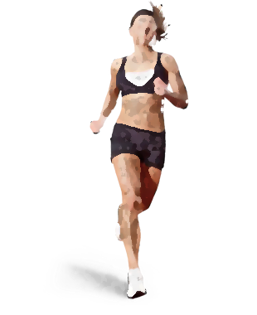

A Prospective Investigation of the Association Between Isometric Muscle Strength and Running Related Injury Among Novice and Recreational Runners.
@Sarah_D_Tweets sarah.dillon24@mail.dcu.ie
Dillon, S. ^{1, 2}, Whyte, E. ¹, Burke, A. ^{1, 2}, O’Connor, S. ¹, Gore, S. ^{1,2}, Moran, K. ^{1, 2}.
¹ School of Health and Human Performance, Dublin City University, Ireland.
² Insight Centre for Data Analytics, Dublin City University, Ireland.

Slide 2
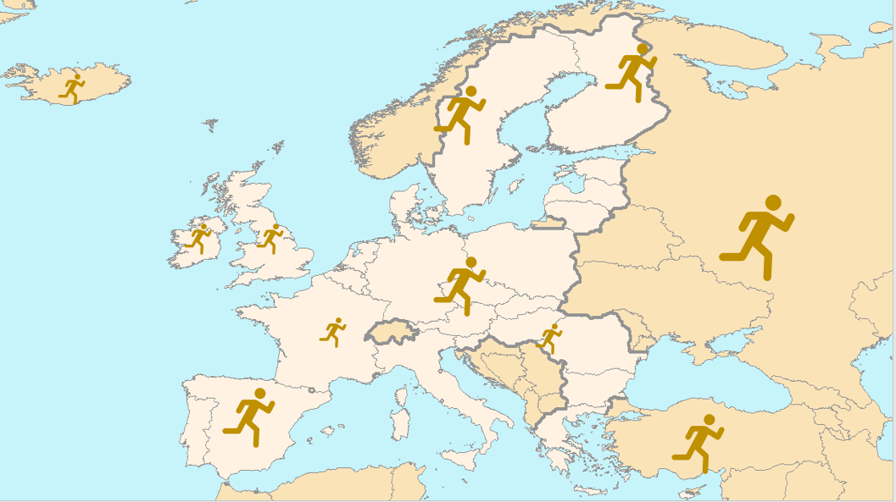


7.9 million people participate in running events worldwide
(Anderson, 2017)
3rd most popular form of exercise
(Irish Sports Council, 2017)
Notes:
Psychological and physical benefits.
Positive effects of running : resting heart rate, body mass, body fat (Hespanhol Junior et al., 2015), associated lower adjusted risks of all-cause and cardiovascular mortality (D. chul Lee et al., 2017) and psychological factors including improvements in self-esteem (Batey, 2014) and decreased odds of depression (McDowell et al., 2018)

Slide 3

Novice runners: 17.8 injuries per 1000 hours
Recreational: 7.7 injuries per 1000 hours
(Videbaek et al., 2015)
Notes:
Alarming- high rates
Despite non-contact and typically submaximal nature of running, there is a high incidence of running injuries. -estimated percentage incidences ranging between 19.4% to 79.3% (Van Gent et al., 2007).
Time out from running being associated with psychological distress, including depression, anxiety, confusion, general mood disturbance and lower self-esteem (Chan and Grossman, 2011).
Additionally, time-loss to injury results in a curtailment of the positive physical health effects gained from involvement.
Therefore, in order to address this it is essential to identify the underlying causes of injury (Meeuwisse et al., 2007).

Slide 4
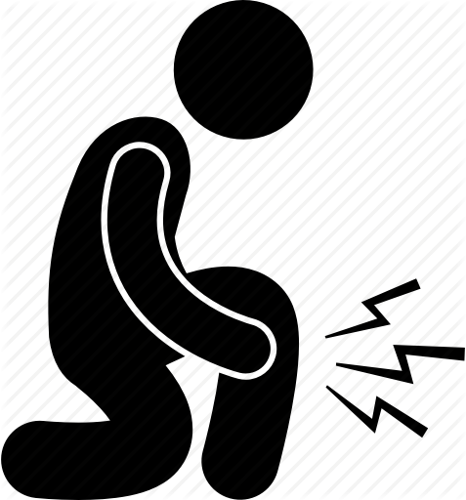


Flexibility
Muscle strength
Technique
Impact Forces
Proposed Injury Risk Factors
Previous injury history
Training load
De Wijer et al. 2015, Van Gent et al. 2007, Ceyssens et al., 2019.
Notes:
Area of interest- because it is potentially modifiable

Slide 5
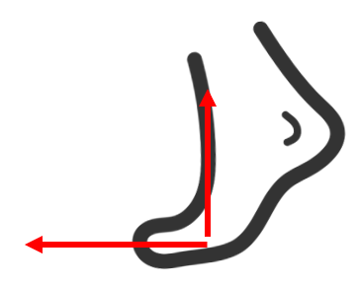

Why study muscle strength?
Role of Muscles
Attenuate forces
(Perry and Burnfield, 1992)
Mediate movement
(Coventry et al., 2006)
Notes:
Powerhouse of movement
Responsible for absorbing some of the impact loads as the runner hits the ground, in conjunction with tendons, bones and other soft tissue structures

Slide 6


Why study muscle strength?
Association between muscle strength and injury
  Decreased muscle strength in injured cohorts
  (Noehren et al., 2014; Frericson et al., 2000; Niemuth et al, 2005)
  Relationship between biomechanics and muscle strength
  (Dierks et al., 2008; Loudon and Reiman, 2012; Ferber et al. 2011)
Notes:
Slide 7:
Noehren and Frericson hip abd in people with ITBS.
Lousdon and Reiman 2012- Runners with MSP displayed greater PT excursion, peak hip IR, and decreased knee flexion while running as compared to a control group. These results should help guide treatment for the running athlete that experiences MSP
Baggaley et al 2015 No relationship was observed between HABD strength and hip adduction during running.
Dierks et al 2008- Runners with PFPS displayed weaker hip abductor muscles that were associated with an increase in hip adduction during running. This relationship became more pronounced at the end of the run
Ferber et al 2011- A 3-week hip-abductor muscle-strengthening protocol was effective in increasing muscle strength and decreasing pain and stride-to-stride knee-joint variability in individuals with PFPS. However, concomitant changes in peak knee genu valgum angle were not observed.

Slide 7


Why study muscle strength?
Clinical Relevance
  Quick and easy
  Screening tool
Notes:
Slide 8:
Clinically applicable measure
Muscle strength may be a screening tool for injury prevention
Govern return to play

Slide 8


Can muscle strength predict running related injury?
Notes:
Research question

Slide 9
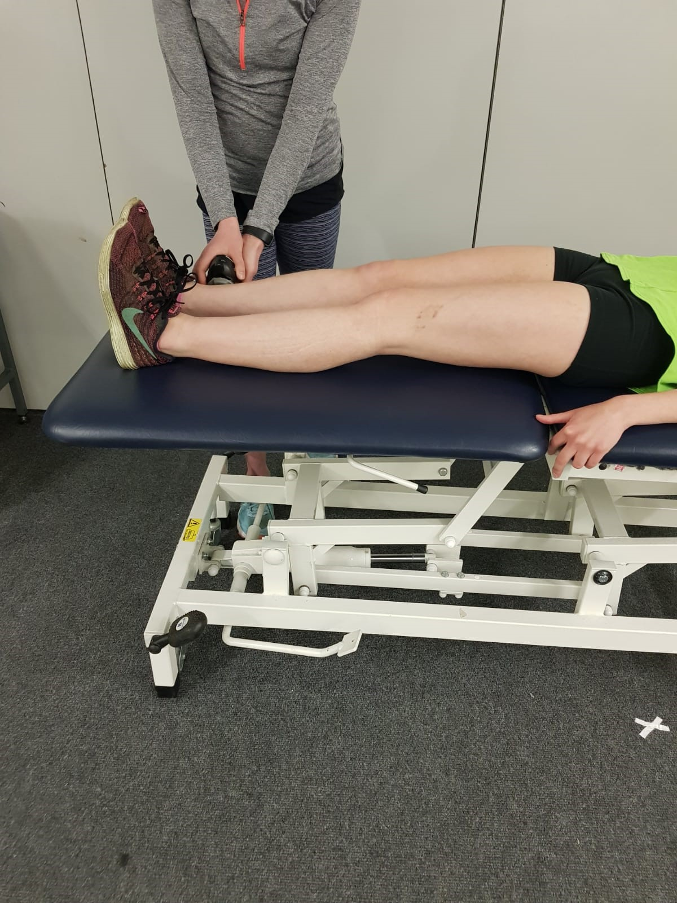
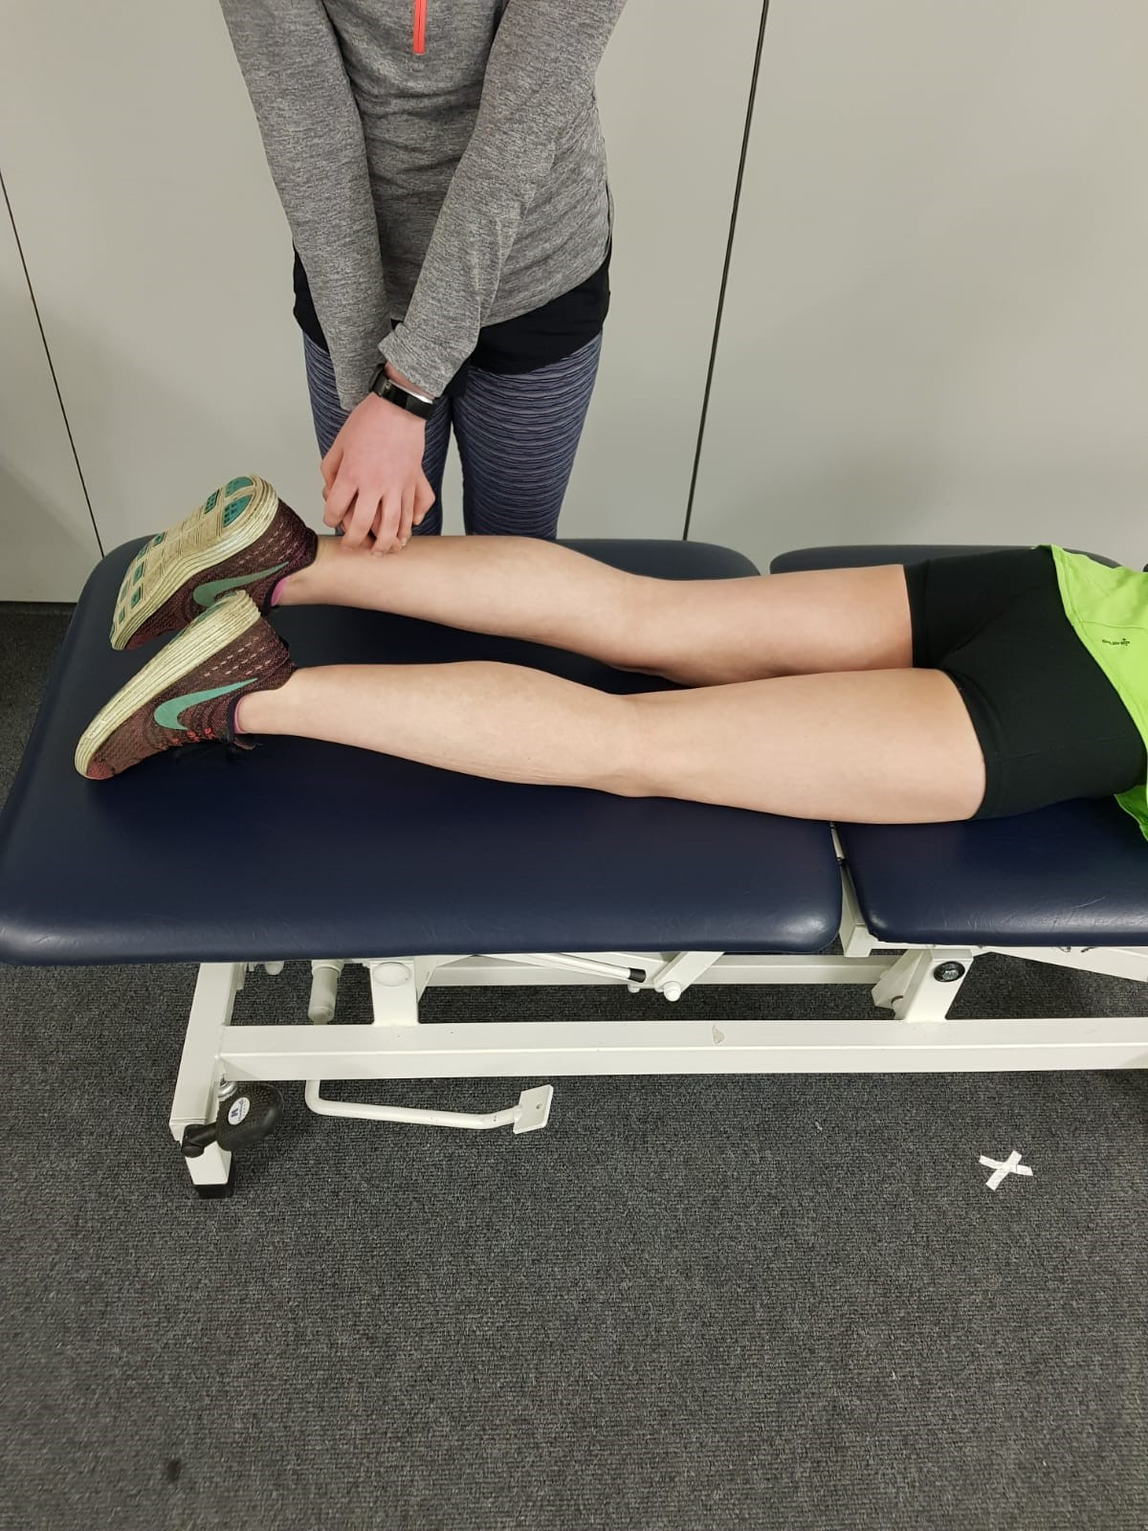
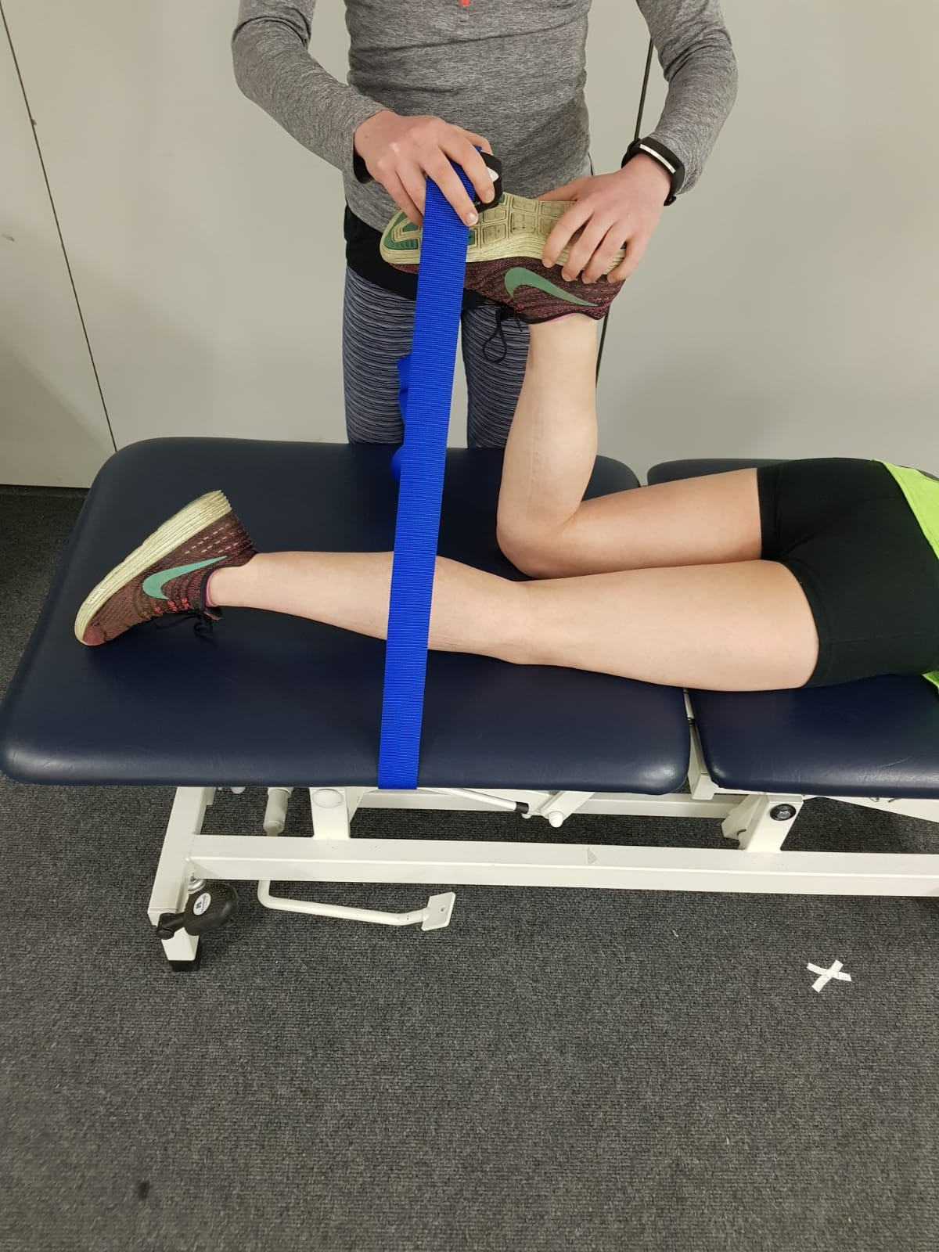
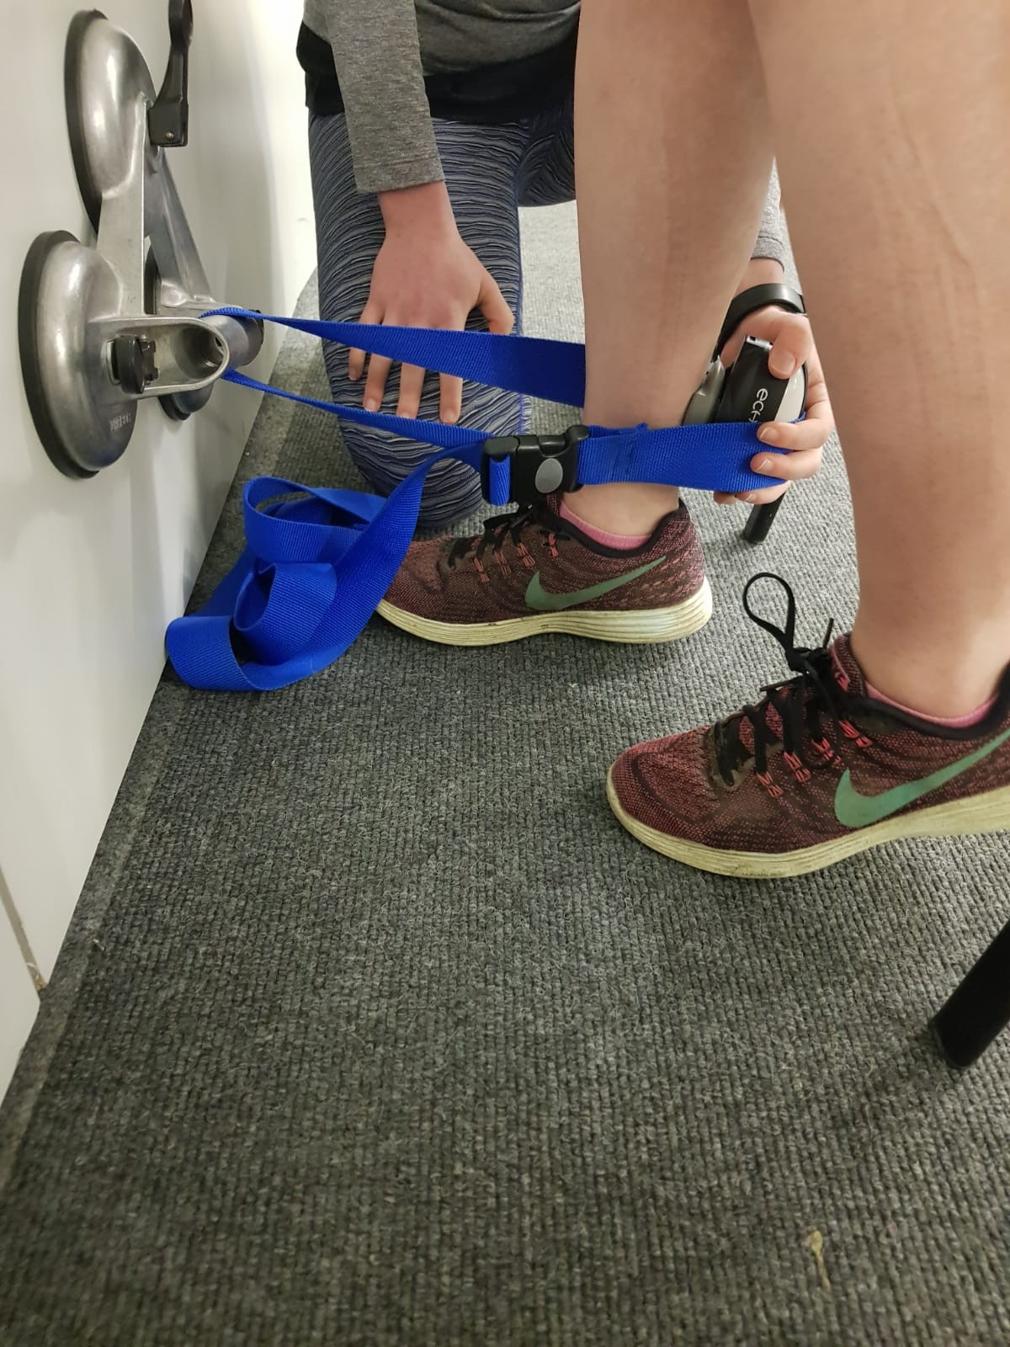
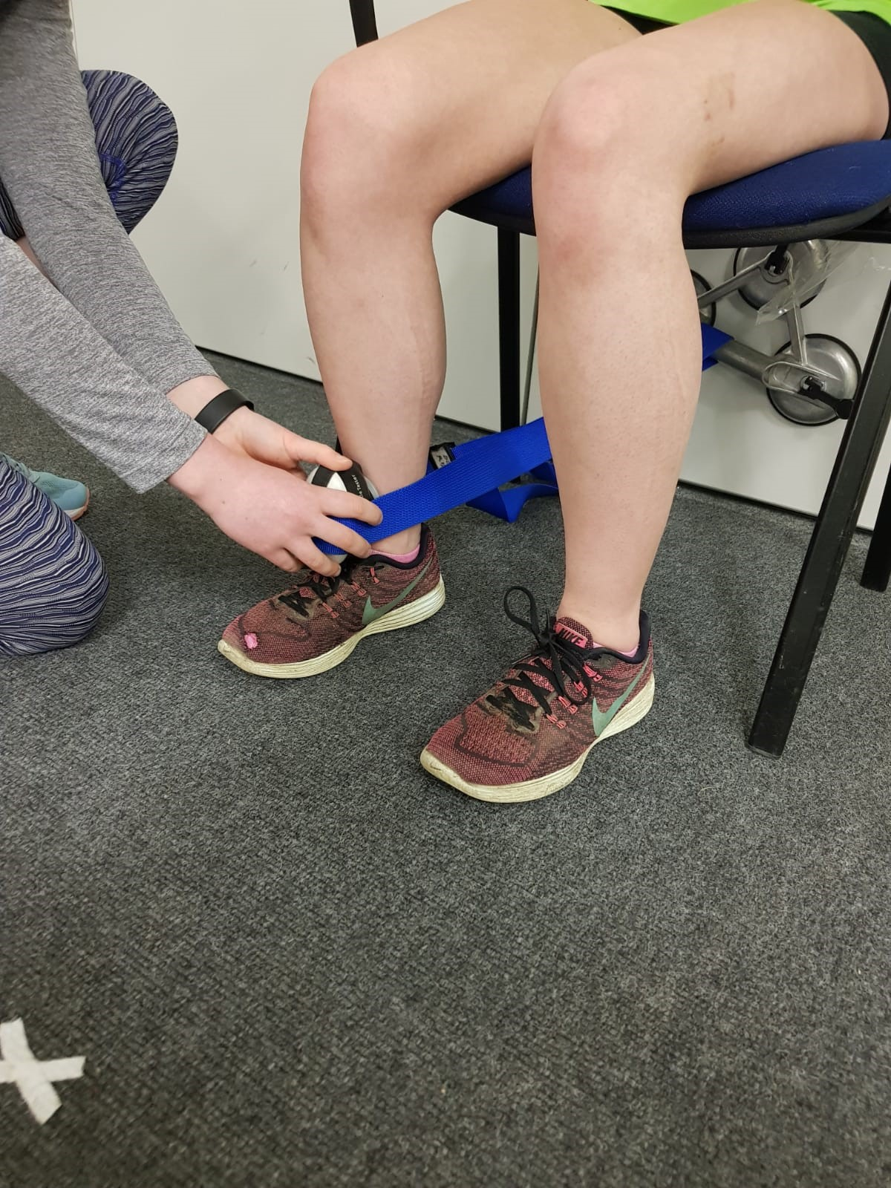
Recruitment
n=176
110 males, 66 females
42±5 years
Isometric Muscle Testing
6 Month Injury Surveillance
Methods
Notes:
Slide 10:
Pain in the lower back/lower limb requiring:
Running restriction for at least 7 days 3 consecutive training sessions
OR
The seeking of professional healthcare advice
(Yamato et al 2016)- consensus statement on running injuries
Muscle testing of the large muscle groups: hip extension, abduction, plantar flexion, knee flexion and extension- three tested with stabilisation belts

Slide 10
Results
34% of sample injured
Notes:
Incidence in line with research which ranges from 25-65%.
Majority of injuries located in lower leg- slightly different to majority of research which cites knee as the most common injury.
Majority of injuries tendinous in nature.
Messier two year study:
At least 1 overuse running injury was sustained by 199 (66%) runners
The knee was the most often injured site of the first injury, followed closely by the foot (Table 1)
Taunton et al. (2002) study, 13 weeks:
The 29.5% injury rate reported in this study is in line with other documented injury rates of 25–65%.
Knee most common site
Van Lun et al (2004) 6 month study:
Sixty nine runners (35 men and 34 women) sustained at least one injury, giving an incidence of 79%.
The most common were foot (15%) followed by thigh (9%) and lower leg (9%).

Slide 11


Results
Stepwise backwards regression.
Statistically significant model generated to predict injury including hip extension strength and age
p=.023, r²=.045-.059, cases classified correctly- 66.7%
High sensitivity: 95.7 %
Low specificity: 10.2%
Notes:
Sensitivity = d/(c+d): The proportion of observed positives that were predicted to be positive. In other words, of all the transactions that were truly fraudulent, what percentage did we find?
Specificity = a/(a+b): The proportion of observed negatives that were predicted to be negatives. In other words, of all the transactions that were legitimate, what percentage did we predict to be so?
R square- nagelkerke how much of the variance in the dependent variable (injury) is explained by8 the model strength age

Slide 12
Results
Null model predicted 66.1% of cases correctly.
Manual muscle strength was not able to accurately predict injury

Slide 13
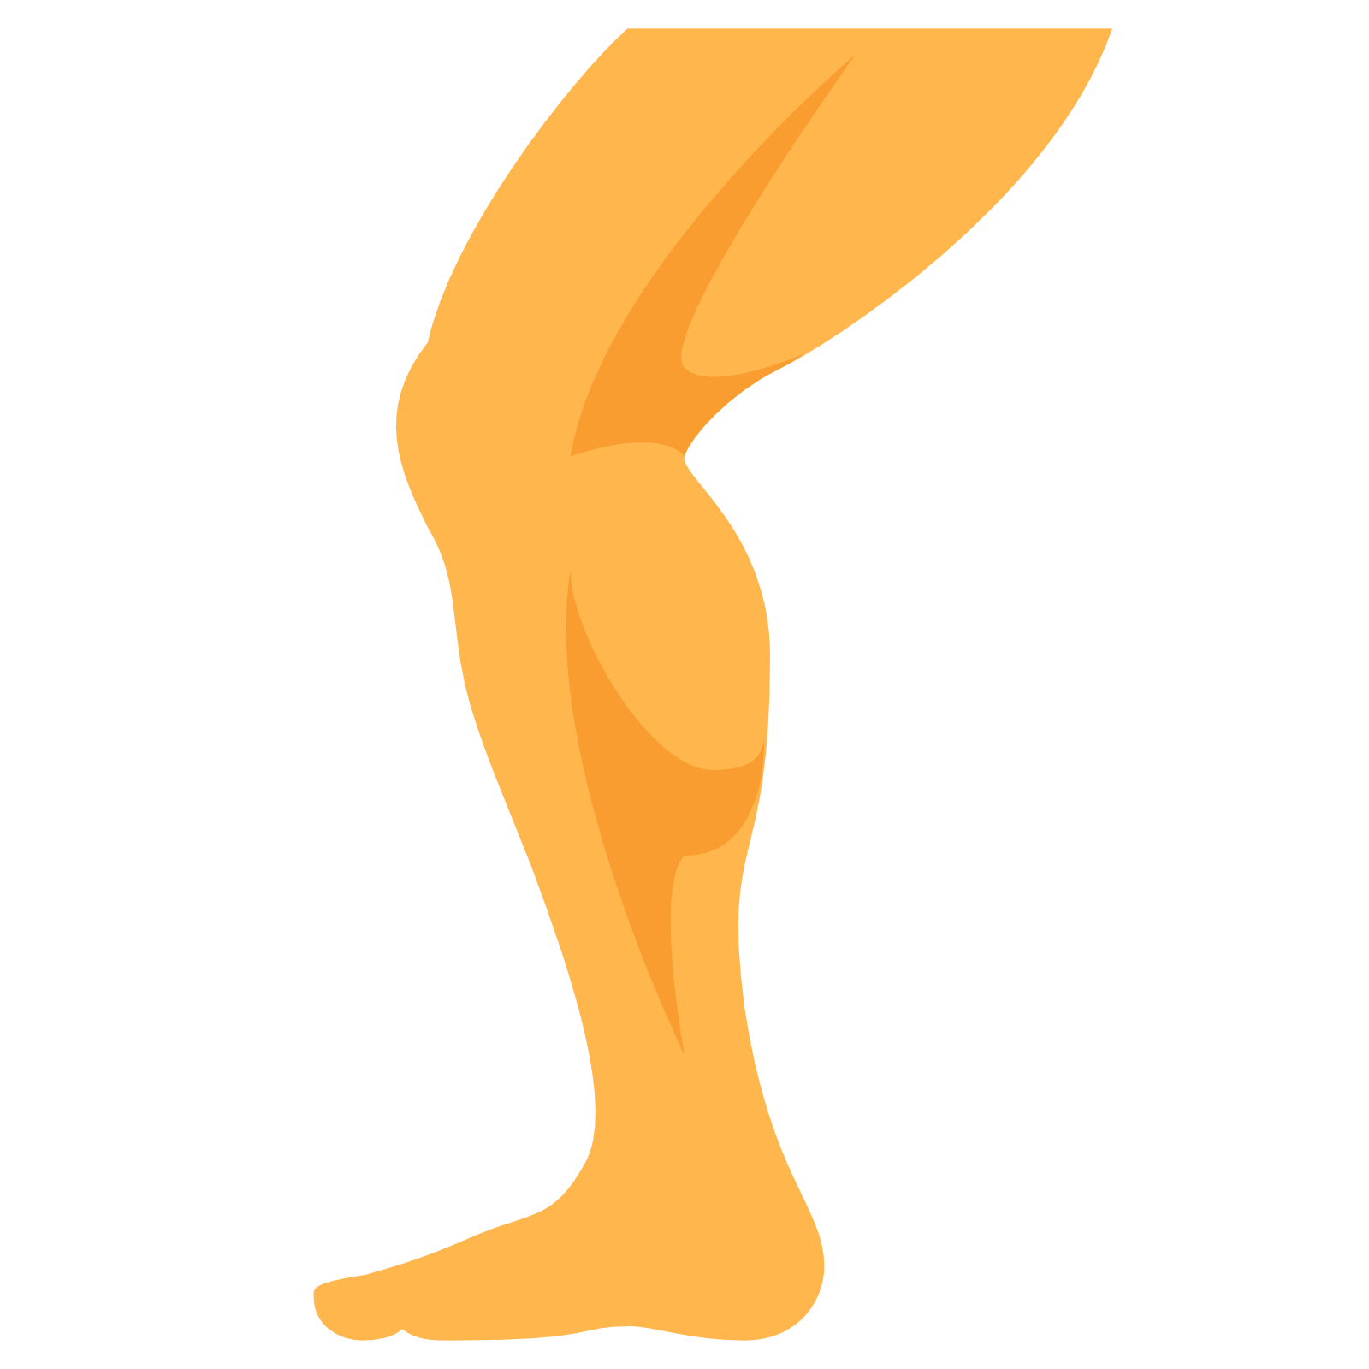
Discussion
In agreement with similar research.
(Thijs et al., 2011; Yagi, Muneta and Sekiya, 2013; Torp et al., 2018).
Strength measures:
May not reflect the ability to effectively implement an injury-resistant running technique .
May not reflect tissue strength.
Notes:
We used isometric contraction- possible limitation
Hip abd:
6 prospective (3 significant difference between groups)
6 retrospective (3 significant diff)
Hip extension:
4 prospective, 2 retro- no sig
Knee Ext-
2 prospective (1 signif diff)
Knee Flexion-
2 prospective (1 signif diff)
Thijs- 10 week prospective study involving novice runners- Tracked PFPS- no significant difference in hip abd strength between controls and those who developed PFPS
Noehren- retrospective- no sig difference in hip abd strength between those currently injured with ITBS and controls
Yagi- Stress fractures and MTSS, prospective, no sig difference, hip abd
Esculier- retrospective, PFPS, no difference between groups, hip abd
Torp- hip Abd general RRI, no difference betweeb groups, prospective g

Slide 14
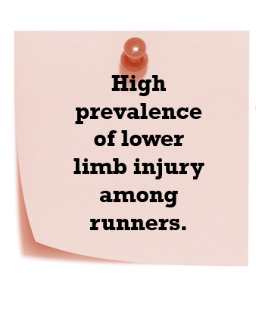
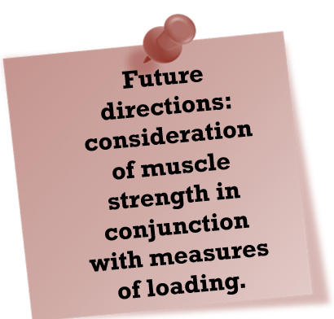
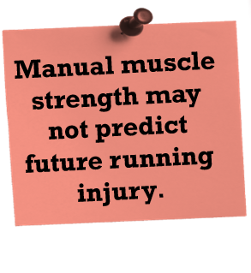
Take Home Messages

Slide 15

Acknowledgments
With thanks to:
Ms Aoife Burke
Dr Kieran Moran
Dr Enda Whyte
Dr Siobhán O’Connor
Dr Shane Gore
Dublin City University
Insight Centre for Data Analytics
RISC Participants

Slide 16
References
Anderson, J. (2019) The State of Running 2019, Published online, Accessible: https://runrepeat.com/state-of-running.
Baggaley, M. et al. (2015) ‘Frontal plane kinematics of the hip during running: Are they related to hip anatomy and strength?’, Gait & Posture, 42(4), pp. 505–510. doi: 10.1016/j.gaitpost.2015.07.064.
Brumitt, J. and Cuddeford, T. (2015) CURRENT CONCEPTS OF MUSCLE AND TENDON ADAPTATION TO STRENGTH AND CONDITIONING, The International Journal of Sports Physical Therapy |. Available at: https://www.ncbi.nlm.nih.gov/pmc/articles/PMC4637912/pdf/ijspt-10-748.pdf (Accessed: 27 May 2019).
Ceyssens, L. et al. (2019) ‘Biomechanical Risk Factors Associated with Running-Related Injuries: A Systematic Review’, Sports Medicine. doi: 10.1007/s40279-019-01110-z.
Coventry, E. et al. (2006) ‘The effect of lower extremity fatigue on shock attenuation during single-leg landing’, Clinical Biomechanics, 21(10), pp. 1090–1097. doi: 10.1016/j.clinbiomech.2006.07.004.
Dierks, T. A. et al. (2008) ‘Proximal and Distal Influences on Hip and Knee Kinematics in Runners With Patellofemoral Pain During a Prolonged Run’, Journal of Orthopaedic & Sports Physical Therapy, 38(8), pp. 448–456. doi: 10.2519/jospt.2008.2490.
Esculier, J. F., Roy, J. S. and Bouyer, L. J. (2015) ‘Lower limb control and strength in runners with and without patellofemoral pain syndrome’, Gait and Posture, 41(3), pp. 813–819. doi: 10.1016/j.gaitpost.2015.02.020.
Ferber, R., Kendall, K. D. and Farr, L. (no date) Changes in Knee Biomechanics After a Hip-Abductor Strengthening Protocol for Runners With Patellofemoral Pain Syndrome. Available at: www.nata.org/jat (Accessed: 17 April 2019).
Fukuchi, R. K. et al. (2014) ‘Flexibility, muscle strength and running biomechanical adaptations in older runners’, Clinical Biomechanics, 29(3), pp. 304–310. doi: 10.1016/j.clinbiomech.2013.12.007.
Van Gent, R. N. et al. (2007) ‘Incidence and determinants of lower extremity running injuries in long distance runners: a systematic review’, Br J Sports Med, 41, pp. 469–480. doi: 10.1136/bjsm.2006.033548.
Lopes, A. D. et al. (2012) ‘What are the Main Running-Related Musculoskeletal Injuries? A Systematic Review’, Sports Med, 42(10), pp. 891–905. Available at: https://www.ncbi.nlm.nih.gov/pmc/articles/PMC4269925/pdf/40279_2012_Article_2301.pdf (Accessed: 20 October 2017).
Loudon, J. K. and Reiman, M. P. (2012) ‘Lower extremity kinematics in running athletes with and without a history of medial shin pain.’, International journal of sports physical therapy. The Sports Physical Therapy Section of the American Physical Therapy Association, 7(4), pp. 356–64. Available at: http://www.ncbi.nlm.nih.gov/pubmed/22893855 (Accessed: 23 April 2019).
Noehren, B. et al. (2012) ‘Proximal and distal kinematics in female runners with patellofemoral pain’, Clinical Biomechanics, 27(4), pp. 366–371. doi: 10.1016/j.clinbiomech.2011.10.005.
Perry, J. and Burnfield, J. M. (1992) Gait Analysis: Normal and Pathological Function. 2nd Editio. Slack Incorporated.
Sport Ireland (Ipsos MRBI) (2015) Ipsos MRBI Irish Sports Monitor 2015 Annual Report. Available at: http://www.sportireland.ie/Research/Irish-Sports-Monitor-Annual-Report-2015/Irish-Sports-Monitor-Annual-Report-2015.pdf (Accessed: 24 October 2017).
Thijs, Y. et al. (2011) ‘Is hip muscle weakness a predisposing factor for patellofemoral pain in female novice runners? A prospective study’, American Journal of Sports Medicine, 39(9), pp. 1877–1882. doi: 10.1177/0363546511407617.
Thomas, A. C. et al. (2018) ‘No baseline strength differences between female recreational runners who developed an injury and injury free runners during a 16-week formalized training program’, Physical Therapy in Sport, 34, pp. 1–7. doi: 10.1016/j.ptsp.2018.08.001.
Videbaek, S. et al. (2015) ‘Incidence of Running-Related Injuries Per 1000 h of running in Different Types of Runners: A Systematic Review and Meta-Analysis’, Sports Med. Springer, 45(7), pp. 1017–26. doi: 10.1007/s40279-015-0333-8.
de Wijer, A. et al. (2015) ‘Injuries in Runners; A Systematic Review on Risk Factors and Sex Differences’, PLOS ONE, 10(2), p. e0114937. doi: 10.1371/journal.pone.0114937.
Yagi, S., Muneta, T. and Sekiya, I. (2013) ‘Incidence and risk factors for medial tibial stress syndrome and tibial stress fracture in high school runners’, Knee Surgery, Sports Traumatology, Arthroscopy, 21(3), pp. 556–563. doi: 10.1007/s00167-012-2160-x.

