Slide 1
Thermo-responsive Poly(Ionic Liquid) Valves for Microfluidic Devices
Alexandru Tudor, Janire Saez, Larisa Florea, Fernando Benito-Lopez and Dermot Diamond

Slide 2
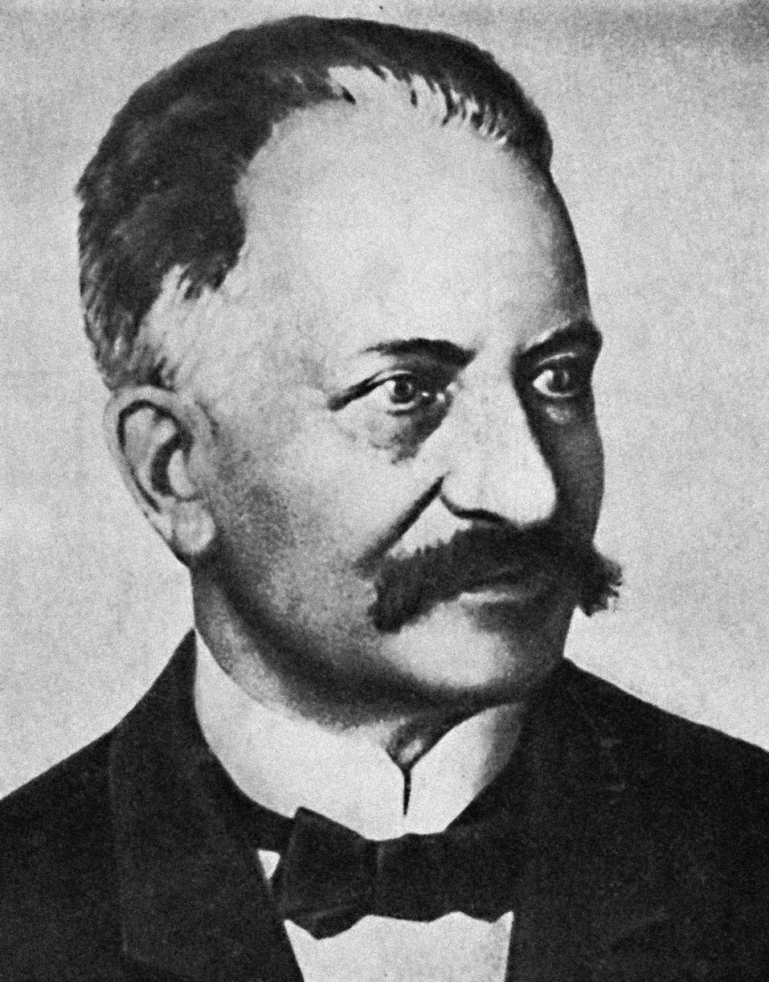
The Origin of Ionic Liquids
1914
Ethylammonium Nitrate
Paul Walden (1863-1957)

Slide 3
Ionic Liquids
Common cations
+
Common anions
-

Slide 4
Ionic Liquid Monomers
Cationic
+
Anionic
-

Slide 5
Crosslinked Poly(Ionic liquid)s
Monomer
Tributylhexyl Phosphonium Sulfopropyl Acrylate (P₄₄₄₆-SPA)
Crosslinker
Polypropylene Glycol Diacrylate

Slide 6
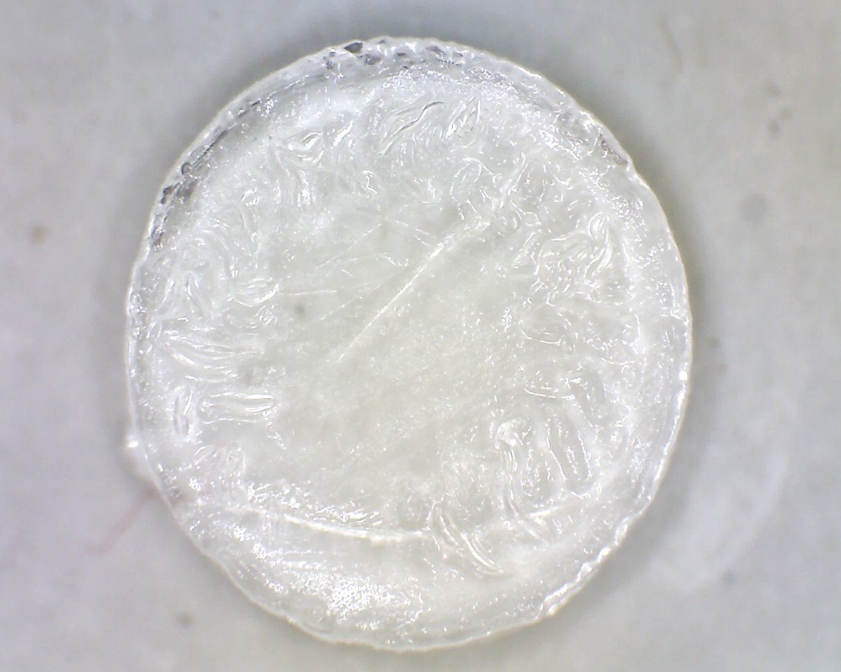
Poly (Ionic Liquid) Hydrogels
P₄₄₄₆-SPA
Photoinitiator
H₂O + Acetonitrile
5 %_{m} Crosslinker
~200 kLux for 30min
1 mm
3 mm
1 mm

Slide 7
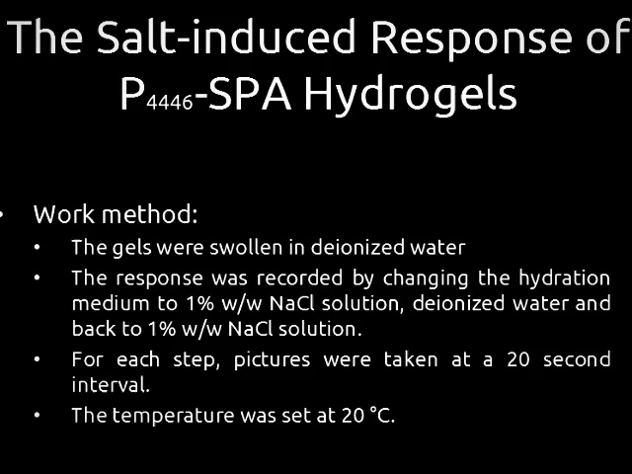
1 mm
1% w/w NaCl
DI Water
1% w/w NaCl

Slide 8
Temperature Responsive Poly(Ionic Liquid)s
+
+
+
+
-
-
-
-
-
-
-
-
+
+
+
+

Slide 9
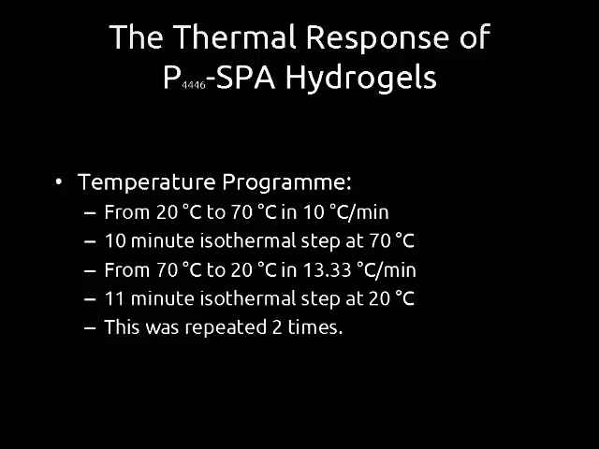
1 mm
Heating
Cooling
Heating

Slide 10
Swelling-Reswelling Cycle
20 ºC
50 ºC

Slide 11
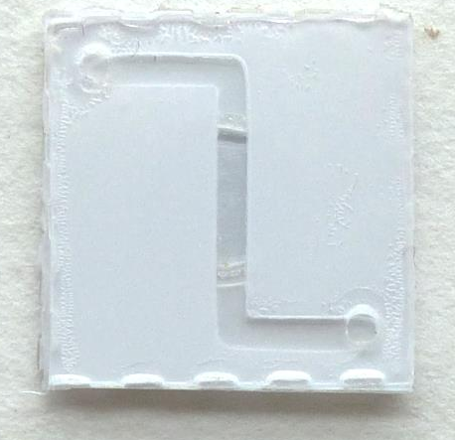
Microfluidic Chip Fabrication
Syringe Pump
500 nL·min⁻¹
Chip
Nanoflow meter
Heater
20 ºC to 50 ºC
Top view
Side view
Channel
Channel
Gel Chamber
Inlet
Gel Chamber
20 ºC to 50 ºC
From
20 ºC to 50 ºC
Outlet
Channel
Gel Chamber

Slide 12
Temperature-regulated Flow
50 °C
20 °C

Slide 13
Shrinking and Swelling Kinetics

Slide 14
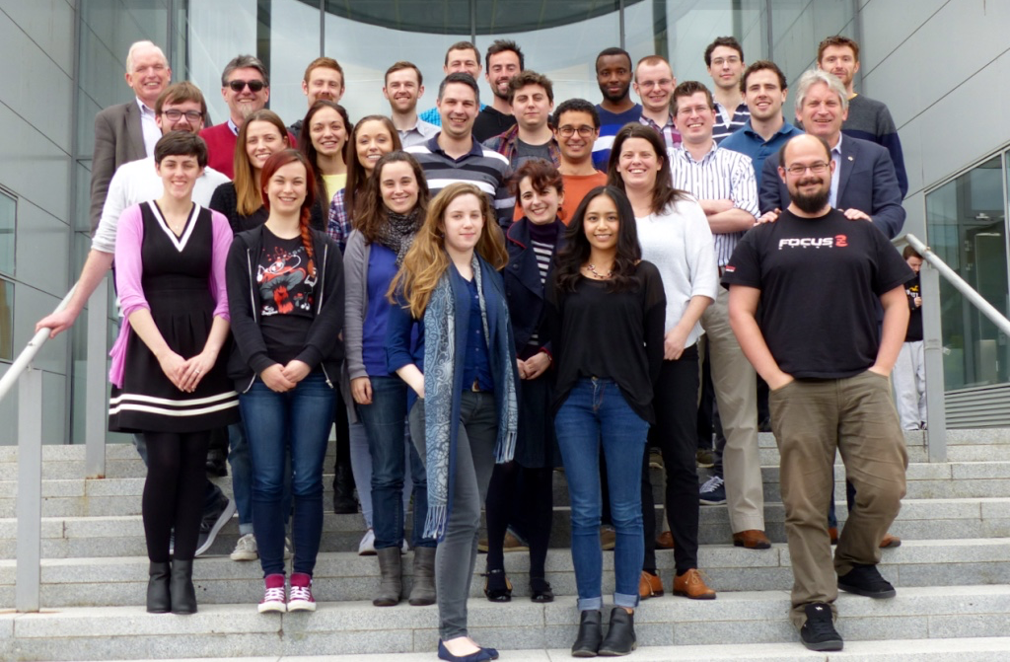










Acknowledgements
Dr. Larisa Florea, Dr. Simon Gallagher, Dr. Simon Coleman.
Dr. Fernando Benito-Lopez, Janire Saez.
Conor O’Quigley, Tom Glennon.
Wayne Francis, Aishling Dunne, Danielle Bruen, Jennifer Deignan.
John Burns, Joseph Hennesy.
Prof. Dermot Diamond.
Marie Curie ITN FP7 OrgBIO project.

Slide 15
Conclusions
Thermo-responsive P₄₄₄₆-SPA hydrogels can be used as temperature-operated valves in microfluidic devices.
Further investigate the possibilities of using the P₄₄₄₆-SPA hydrogels as flow regulators in microfluidic chips.

Slide 16
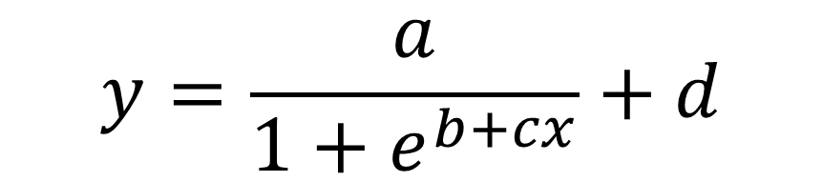
Valve shrinking kinetics
$$y=\frac{a}{1+e^{b+cx}}+d$$
Where:
the maximum value of the curve
the intercept
the slope
the offset

Slide 17
Rate constant calculation results
Shrinking |  |  | Swelling
Repetition | C |  | Repetition | C
1 | 0,89 |  | 1 | 0,91
2 | 0,36 |  | 2 | 0,94
3 | 0,52 |  | 3 | 0,83
4 | 0,80 |  | 4 | 0,38
5 | 0,67 |  | 5 | 0,49
6 | 0,62 |  | 6
MEAN | 0,64 |  | MEAN | 0,71
DESVEST | 0,19 |  | DESVEST | 0,26
RSD (%) | 29,80 |  | RSD (%) | 36,41

Slide 18
1 mm

Slide 19
Salt Concentration Induced Shrinking
1% w/w NaCl
DI Water
1% w/w NaCl

Slide 20
1 mm

Slide 21
Temperature-induced Shrinking Kinetics
Heating
Cooling
Heating

Slide 22
Valve Shrinking Kinetics

Slide 23
Valve Swelling Kinetics

