Slide 1


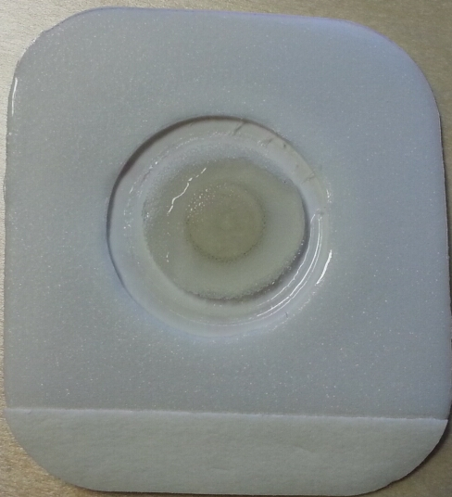
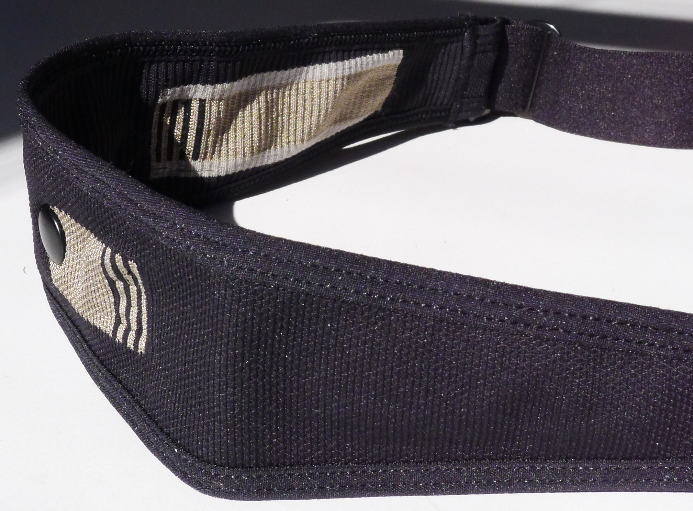

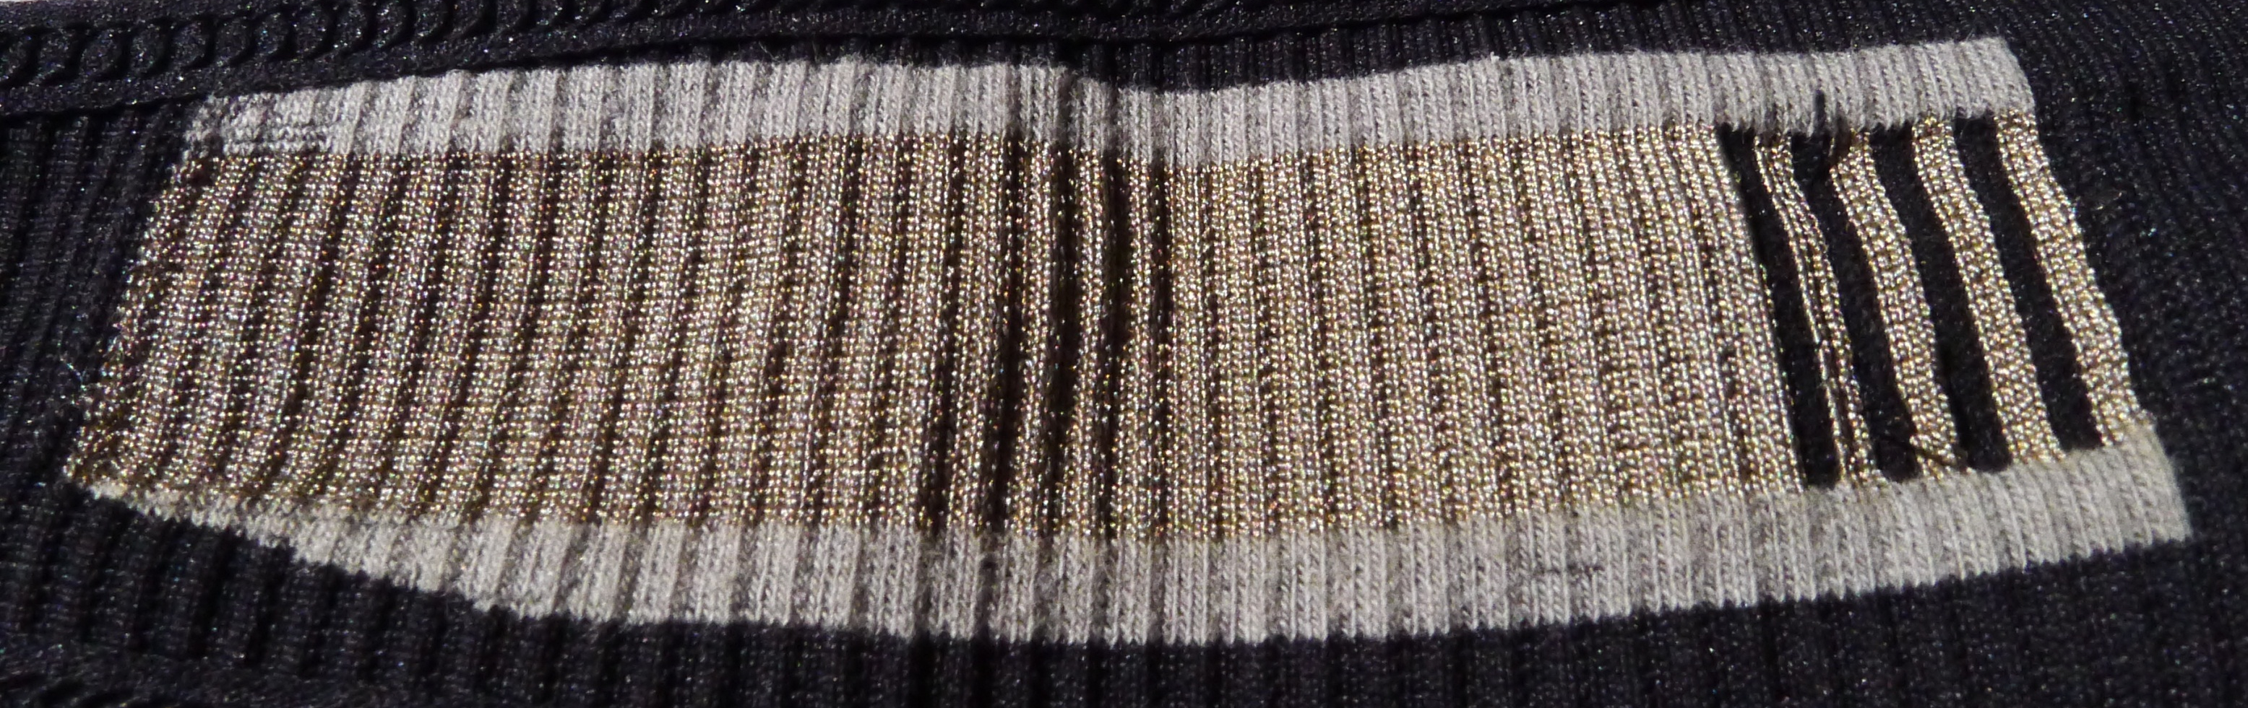
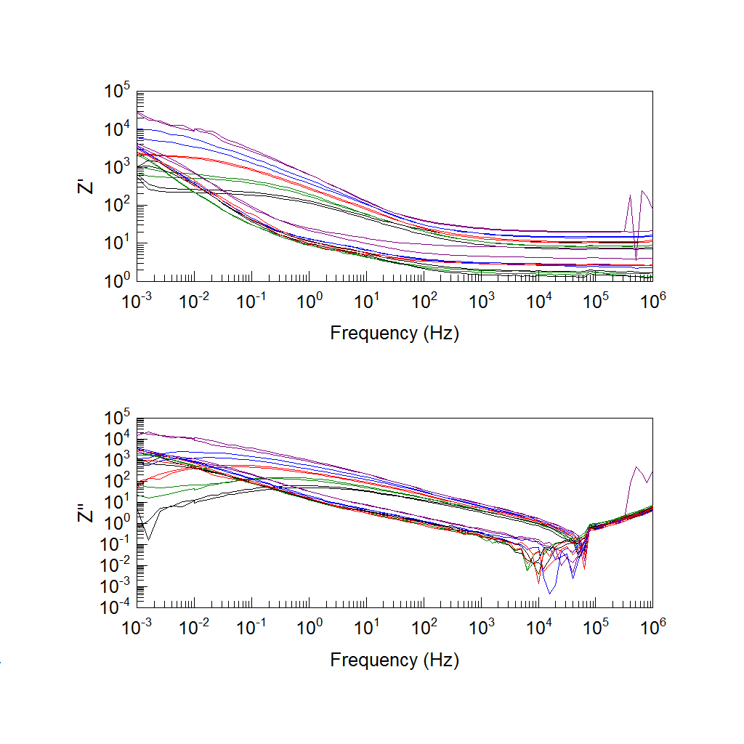





Wearable Chemical Sensors: Characterization of ECG Electrodes with Electrochemical Impedance Spectroscopy
Jennifer Deignan¹, Michael McBrearty², Javier Monedero³, Shirley Coyle¹, Donal O’Gorman³, Dermot Diamond¹
¹Insight Centre for Data Analytics, National Centre for Sensor Research, Dublin City University, Ireland.
²adidas Wearable Sports Electronics, Chadds Ford, Pennsylvania, United States.
³School of Health and Human Performance, Dublin City University, Ireland.
Introduction
Wearable monitoring systems have become very popular in the health and sports industry in recent years, with comfort of the device becoming a high priority. However, it is important that accuracy does not suffer for the sake of comfort. Hospital monitoring electrodes are accurate in large part due to the reduction-oxidation reaction of Ag/AgCl. This work presents a testing method to compare future generations of heart rate monitoring devices to the current standard of disposable Ag/AgCl electrodes.
Background
Blocking and Non-blocking Electrodes
R1
CPE
L1
R1
R2
L1
CPE
Standard Ag/AgCl disposable monitoring electrodes rely on the well known AgCl + e⁻ ↔Ag + Cl⁻ reduction-oxidation reaction to produce clear, reliable electrocardiogram (ECG) signals for inpatient monitoring. As these electrodes are unsuitable for athletic monitoring due to comfort, ease of use, and data capture, a range of heart rate monitoring straps have been developed. However, these straps are typically made of silver coated fabric or carbon black and lack the reduction-oxidation reaction which make Ag/AgCl electrodes so accurate.
Textile electrodes are considered blocking electrodes as they display no charge transfer behavior that is seen in non-blocking electrodes. This can be seen in the above graph as the textile electrodes show no consistent trend in resistance with respect to temperature change while the resistance of the 3M electrodes decreases with increasing temperature.
On-body Testing
Impedance Measurements
Without electrode gel on textile electrode
(74 bpm)
3M electrodes
(40 bpm)
Textile electrodes
With electrode gel on textile electrode
1°C
(78 bpm)
13°C
25°C
(74 bpm)
37°C
49°C
3M electrodes
Resting ECG measurements were taken on a healthy adult male with both electrodes simultaneously. Without electrode gel, the textile electrodes showed erratic behavior, with sudden increases and decreases in heart rate that were not present with the 3M electrodes.
Textile electrodes
Conclusions
Wearable sensors can provide continuous monitoring for health, sports and exercise. Heart rate monitors are integral to the creation of whole body monitoring systems. With small enhancements, the accuracy of textile based sensors can be dramatically improved and such whole body systems could be realized.
3M Red Dot 2230 diaphoretic monitoring electrodes were tested against an adidas textile strap. An impedance sweep from 1MHz to 1mHz was conducted on the samples at 1°C, 13°C, 25°C, 37°C and 49°C. The data was then modeled to the appropriate equivalent circuit for each sample.
Acknowledgments
Science foundation Ireland under the Insight initiative, grant SFI/12/RC/2289 and IRSES-GA-2010-269302.

