Slide 1
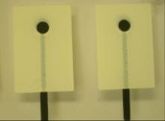
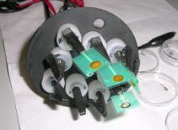
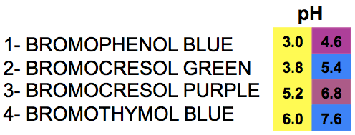
Recent Progress in Disposable Ion-selective Sensors for Environmental Applications
Giusy Matzeu, Claudio Zuliani and Dermot Diamond
CIMTEC 2012,
Montecatini Terme

Slide 2
Summary
Introduction
Ion Selective Electrodes (ISEs)
Lead ISEs: Optimization for reproducibility
POT
PEDOT
New materials for the solid contact
Gold Nanoparticles (GNPs)
1

Slide 3
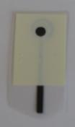
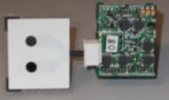
Introduction
Analyte
Ion Selective Electrode (ISE) able to detect the analyte of interest
Chemo/Bio
Sensing
ISE integrated into a wireless device for in situ monitoring
Wireless Data Transmission
● Introduction ● Solid Contact Materials ● Conclusions ● Future Trends
2

Slide 4
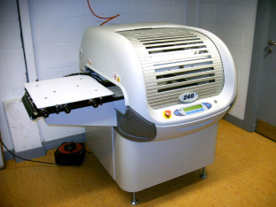
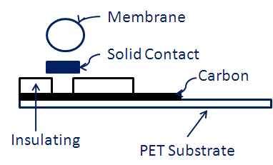
How to make an ISE
Screen Printing Technology
Cost
Reproducibility
OPTIMIZATION in terms of SOLID CONTACT
through Lead ISEs using different materials
● Introduction ● Solid Contact Materials ● Conclusions ● Future Trends
3
Notes:
Substrates can be adapted for the appropriate sensing strategy

Slide 5
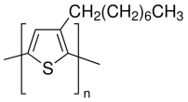
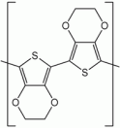
Solid Contact materials
The materials under analysis in terms of reproducibility:
Poly(3-octylthiophene-2,5-diyl) (POT)
Poly(3,4-ethylenedioxythiophene) (PEDOT)
Gold nanoparticles soluble in water or
methanol
● Introduction ● Solid Contact Materials ● Conclusions ● Future Trends
4
Notes:
investigation of materials to improve repro. of lead sensors

Slide 6
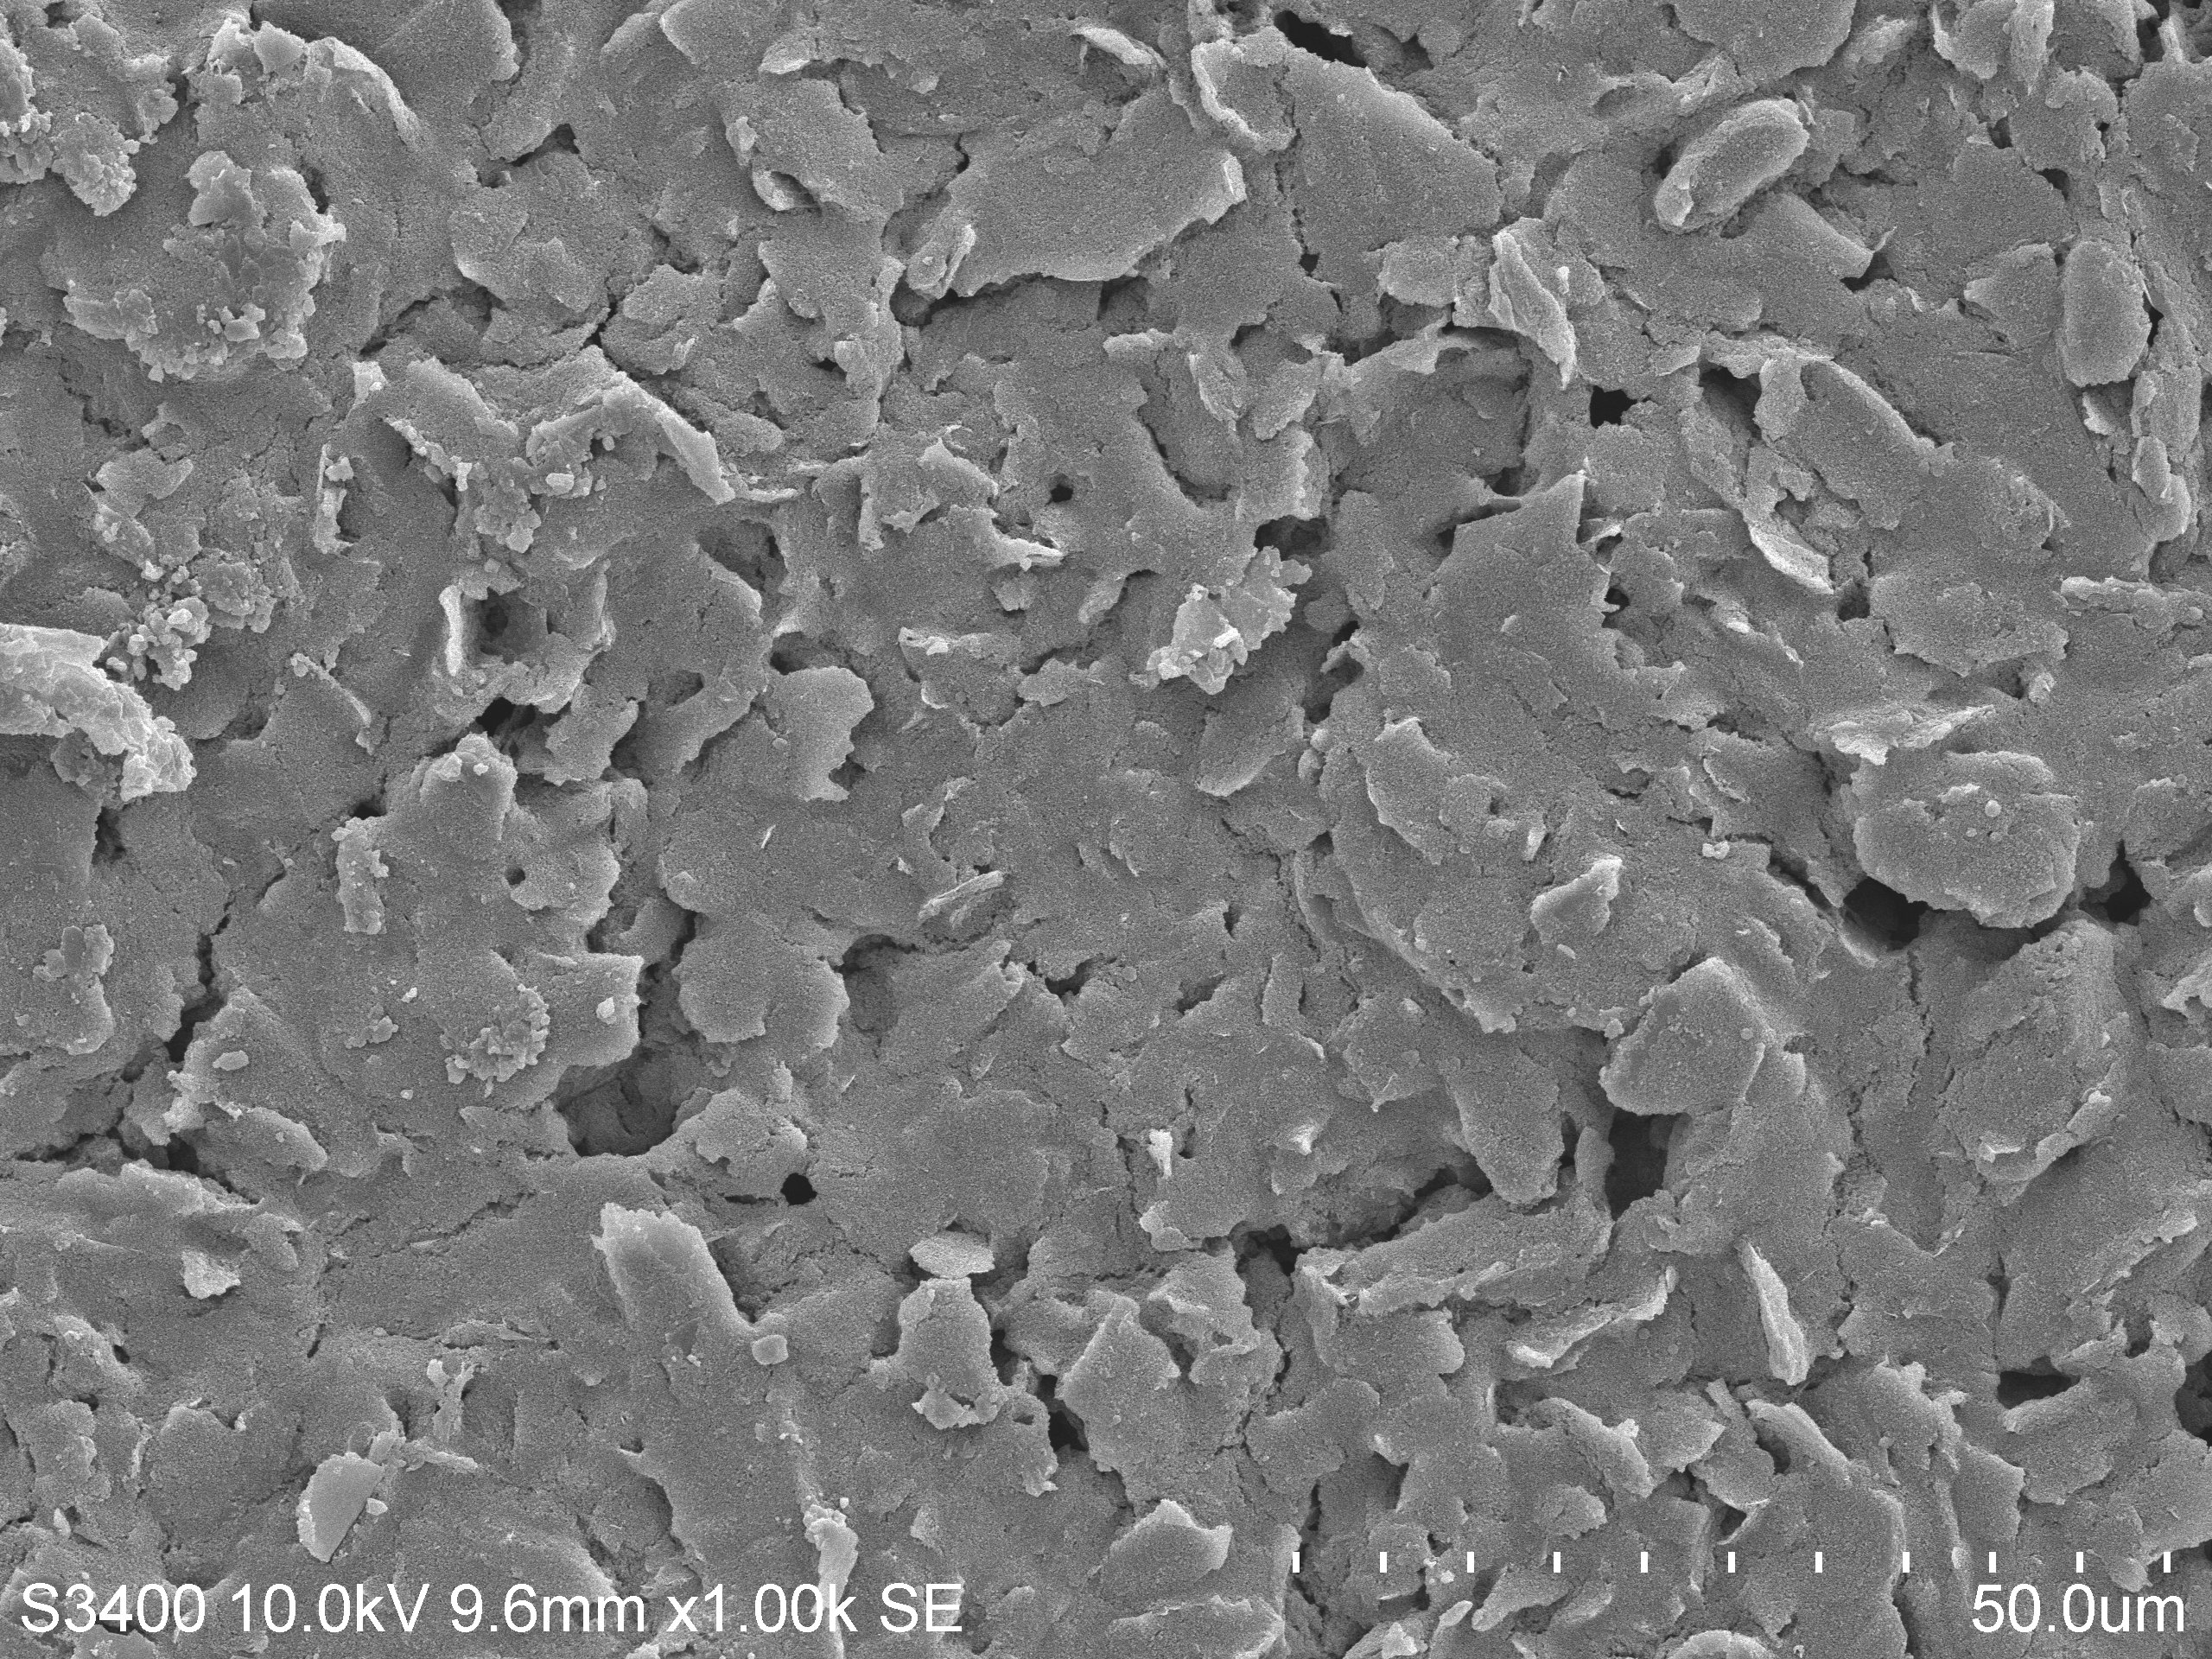
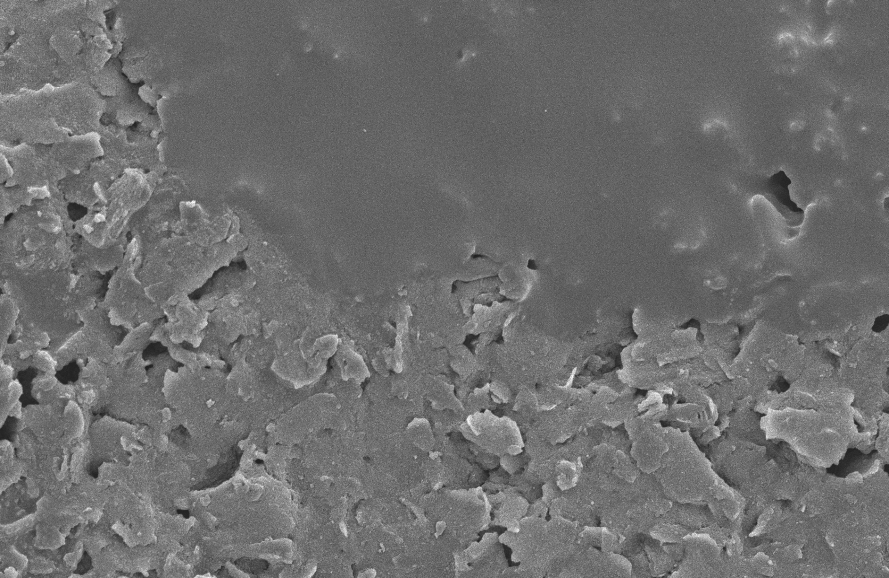
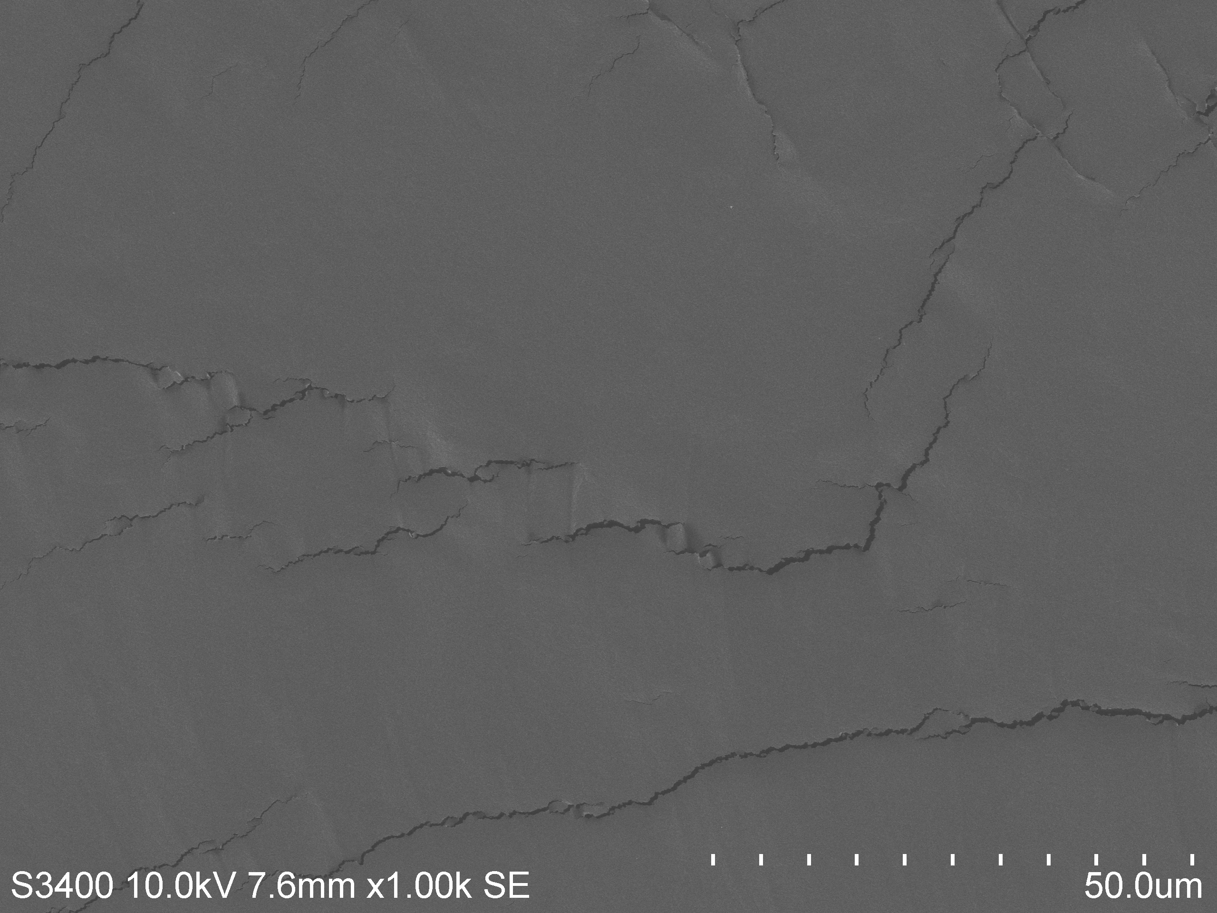
POT
POT was drop cast in different amounts
THICKNESS is changing
50 μm
50 μm
50 μm
● Introduction ● Solid Contact Materials ● Conclusions ● Future Trends
5
Notes:
aims
Optimization of a material and study of different materials
POT thickness

Slide 7
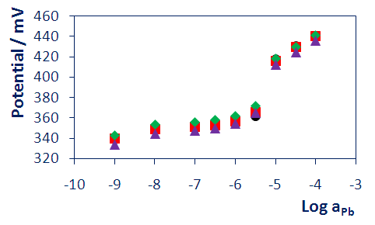
POT
Example of a calibration curve realized using POT like solid contact layer
SPE | Sensitivity (mV) | Baseline (mV)
1 | 48.15 | 339.3
2 | 46.36 | 339.7
3 | 43.16 | 343.9
4 | 44.43 | 333.7
● Introduction ● Solid Contact Materials ● Conclusions ● Future Trends
6

Slide 8
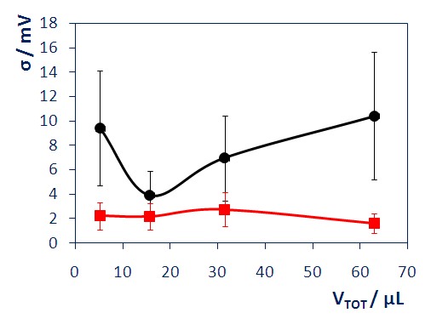
POT
How the performances of the Lead ISEs were affected in changing the amount of POT drop cast
● Standard deviation for the baseline of the ISEs
■ Standard deviation for the sensitivity of the ISEs
● Introduction ● Solid Contact Materials ● Conclusions ● Future Trends
7

Slide 9
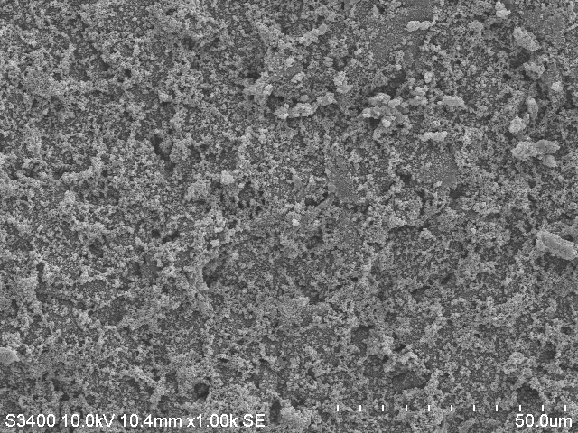
PEDOT
For PEDOT the performances are affected by the thickness and the redox state of the conducting polymer
50 μm
50 μm
● Introduction ● Solid Contact Materials ● Conclusions ● Future Trends
8

Slide 10
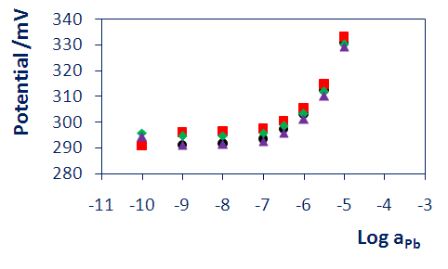
PEDOT
Example of a calibration curve realized using PEDOT like solid contact layer
SPE | Sensitivity (mV) | Baseline (mV)
1 | 27.57 | 289.1
2 | 27.45 | 294
3 | 27.06 | 292.7
4 | 28.02 | 288.8
● Introduction ● Solid Contact Materials ● Conclusions ● Future Trends
9

Slide 11
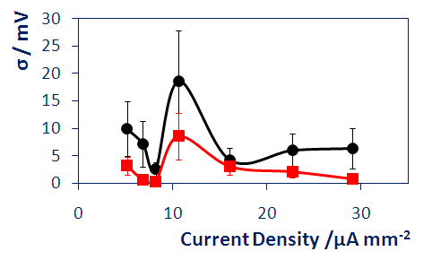
PEDOT
How the performances of the Lead ISEs were affected in changing the current density during the electrodeposition of PEDOT
● Standard deviation for the baseline of the ISEs
■ Standard deviation for the sensitivity of the ISEs
● Introduction ● Solid Contact Materials ● Conclusions ● Future Trends
10

Slide 12
GNPs
GNPs used like solid contact for different reasons:
possibility of tuning in changing the solvent and the ligand for specific applications
tuned to directly bind the metal ion of interest
like others nanomaterials, ability to increase the surface area of the sensitive part of the solid contact
● Introduction ● Solid Contact Material ● Conclusions ● Future Trends
11

Slide 13
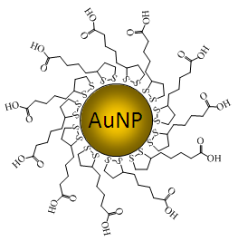
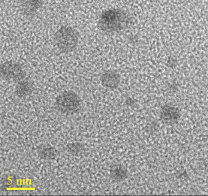
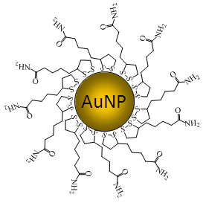
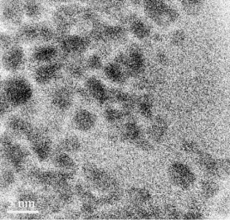
GNPs
Thioctic Acid GNPs Thioctic Amide GNPs
soluble in water
functionalization by ligand exchange
d_{mean} = 3.6 ± 0.6 nm
soluble in DMSO
functionalization by ligand exchange
d_{mean} = 3.5 ± 0.7 nm
● Introduction ● Solid Contact Material ● Conclusions ● Future Trends
12
Notes:
checking the size distribution

Slide 14
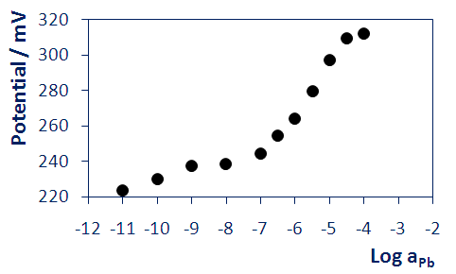
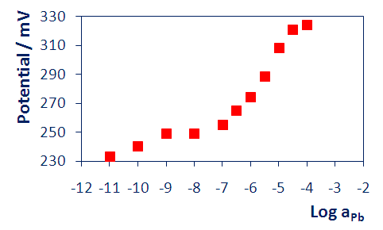
GNPs
Thioctic Acid GNPs
10 monolayers
SENSITIVITY: 26.68 mV
LOD: 6.87
50 monolayers
SENSITIVITY: 31.91 mV
LOD: 6.53
● Introduction ● Solid Contact Material ● Conclusions ● Future Trends
13
Notes:
checking the size distribution

Slide 15
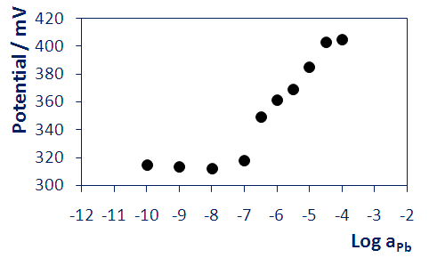
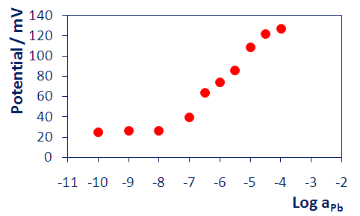
GNPs
Thioctic Amide GNPs
10 monolayers
SENSITIVITY: 33.93 mV
LOD: 7.2
50 monolayers
SENSITIVITY: 26.36 mV
LOD: 7.9
● Introduction ● Solid Contact Material ● Conclusions ● Future Trends
14
Notes:
checking the size distribution

Slide 16
.
Conclusions
The study of optimization for screen printed electrodes using different materials for the solid contact showed:
POT: dependence from the thickness of the conducting polymer
PEDOT: dependence from the thickness and the redox state of the conducting polymer
GNPs were used for the first time like solid contact on top of screen printed electrodes and tuning the ligand
Improvements into the LOD
● Introduction ● Solid Contact Materials ● Conclusions ● Future Trends
15

Slide 17
.
Future Trends
Need for an optimization of the other key layer
MEMBRANE
Optimization into the use of GNPs (best ligand, solvent) to have to exploit all their different properties
Creation of calibrationless sensors directly integrated into wireless platforms for environmental/wearable applications .
● Introduction ● POT ● PEDOT ● GNPs ● Conclusions ● Future Trends
16

Slide 18
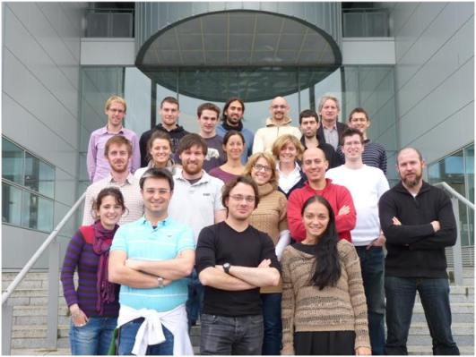
Acknowledgements
Dr. Claudio Zuliani
Prof. Dermot Diamond
All the people in room N205 and SG03
We would like to acknowledge Science Foundation Ireland - 07/CE/I1147 – supporting "CLARITY: Centre for Sensor Web Technologies"
17

