Slide 1
Towards Wearable Sensors for Wireless pH Monitoring in Sweat
Giusy Matzeu, Claudio Zuliani, Dermot Diamond
Clarity, Centre for Sensor Web Technology, Dublin City University, Ireland
Pittcon, 14/03/2012
1

Slide 2
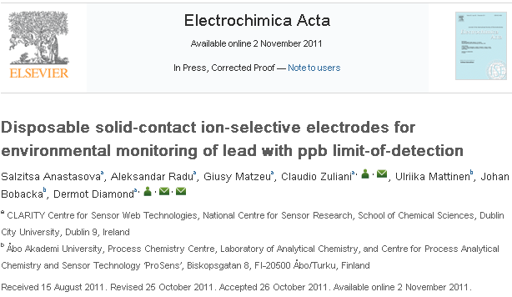
2

Slide 3


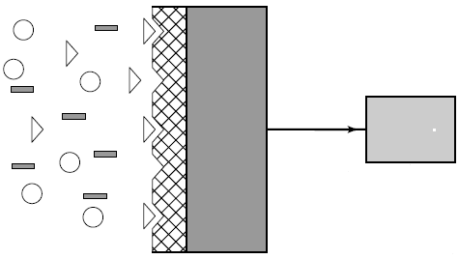


Sensors for the Digital World
Analyte
Chemo/Bio Sensing
Wireless data transmission
4

Slide 4
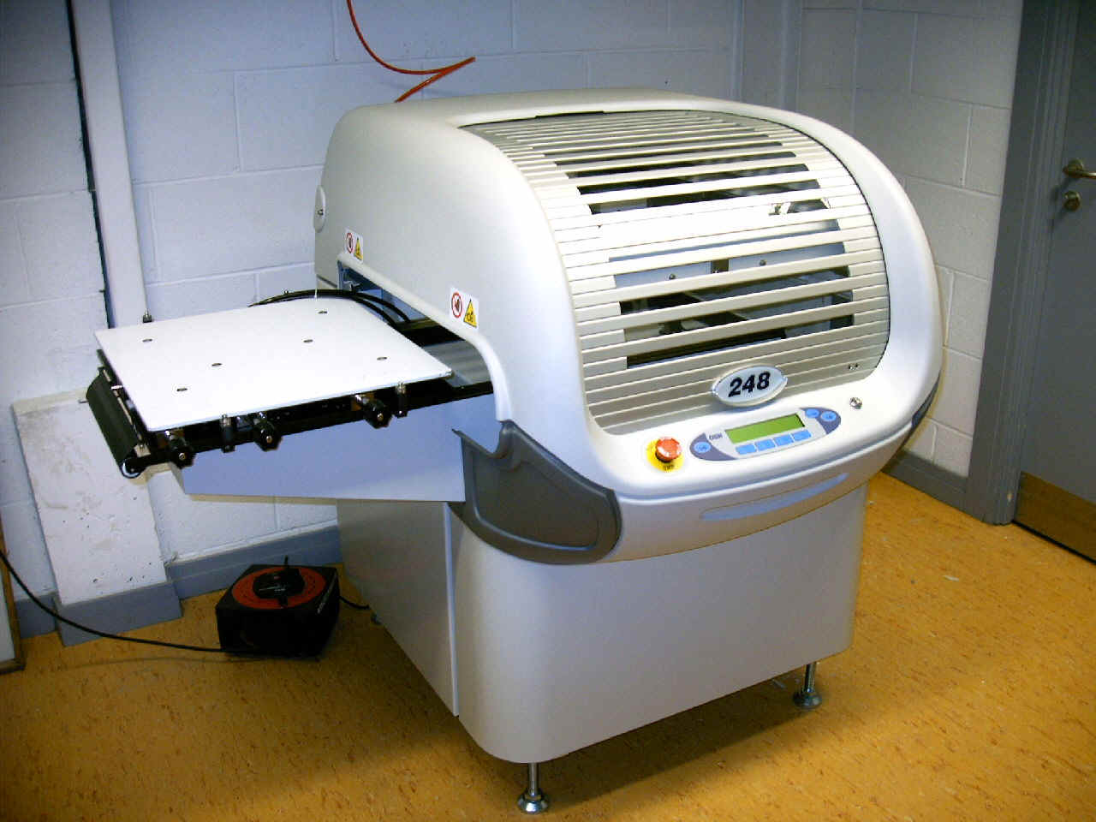
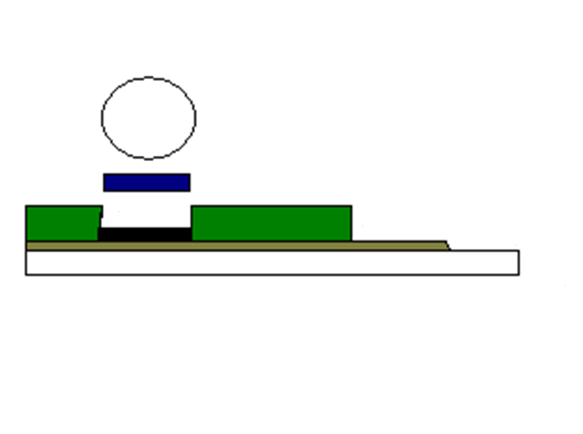
Sensors for the Digital World
Cost
Reproducibility
Compatible with Wearable & Environmental Applications
IS-Membrane
Conducting Polymer
Silver
Carbon
PET Substrate
Resist
5

Slide 5
pH ISE – An Initial Design
1st calibration after overnight conditioning
Sensors and Actuators B, 2010, 146 , 19
2nd calibration after 3days in the conditioning solution
Loss of linearity & offset change over time.
May we improve this limit working on SPE fabrication ?
6
Notes:
Membrane Composition:
● PVC 32.3% , o-NPOE 66.6%, KTpClPB 0.48%, H Ionophore II 0.66%
Dissolved in 3 ml of THF
Conditioning: Buffer 0.001 M di acido citrico, acido borico and Na2HPO4 a pH 4 overnight
Density of POT 2.75 mg/ml in 3 ml of chloroform.
30 ul of POT were drop cast on top of the electrodes

Slide 6
“Initial” vs “New” SPE
7

Slide 7
“Original” vs “New” SPE
Original SPE
0.3 < σ < 0.6
New SPE
σ ≈ 1.6
8

Slide 8
pH ISEs – Silverless-SPE and Membrane Thickness
Carbon prints were masked used PSA and PMMA. PET substrate were laminated with PSA and PMMA after that tracks carbon was screen printed: Integration of ISE within microfluidic system
175 μm PMMA + 50 μm PSA as masking layer
500 μm PMMA + 50 μm PSA as masking layer
550 μm well allows a better reproducibility !
10

Slide 9
pH ISEs – Performance over Time & Storage
Calibration repeated after 5 days storage in conditioning solution
Day 0
Day 5 (kept in conditioning solution)
Day 19 (kept in dry conditions)
Printing protocols, e.g., presence of Ag,, have a significant impact in sensor reproducibility over time !
Dry storage may preserve sensor functionality !
11

Slide 10
Reference Electrodes based on Lipophilic Salts on SPE
SC=PEDOT
U. Mattinen, J. Bobacka, A. Lewenstam, Electroanalysis 2009, 21, 1955.
1 mM NaCl
0.1 M KCl
0.1 M NaCl
0.1 M KCl
SC=PEDOT
SC=POT
1 mM KCl
1 mM KCl
0.1 M NaCl
0.1 M KCl
1 mM NaCl
0.1 M KCl
Cl⁻ ≈ 20 mV/decade
Need optimisation
Possibility for RE where [Cl⁻] is constant
13

Slide 11
Mote Interface and Wireless Communication
Bias between motes and standard instrumentation < 0.3mV
Bias between motes < 0.1 mV
• Mote 1
• Mote 2
• Mote 3
• 16Ch-Lawson Labs
14

Slide 12
Dual SPE – Integration of pH & RE on same substrate
The two carbon disks printed on the PET substrate will be modified to give a pH and a reference electrode
The substrate can also be laminated with PSA and PMMA for futher integration within microfluidics.
Work currently under progress to optimize sensor response !!
15

Slide 13
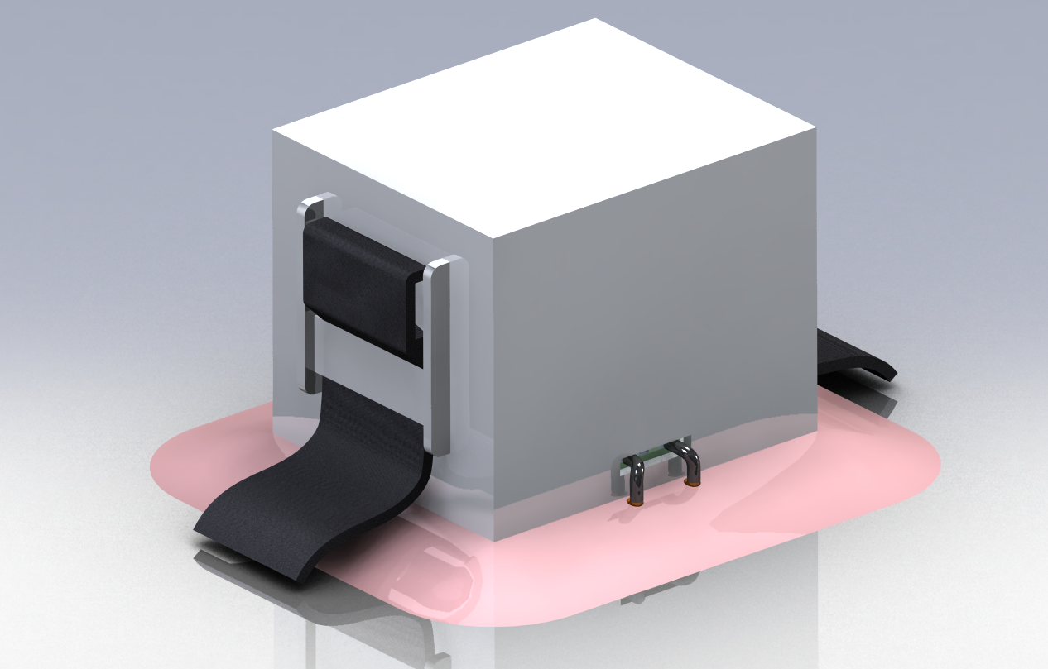
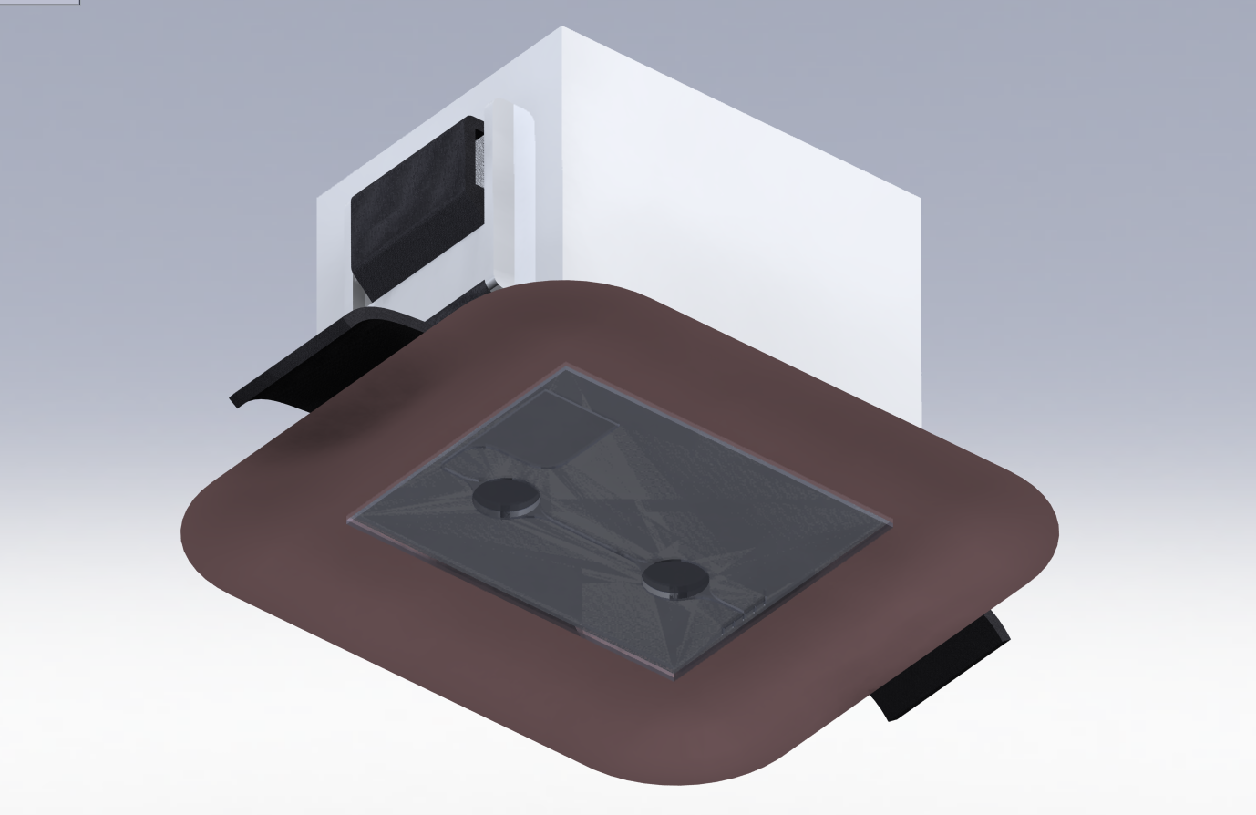
Wearable pH Sensor –Concept
Mote Casing
Patch
Strap
Sensor + Microfluidic
16

Slide 14
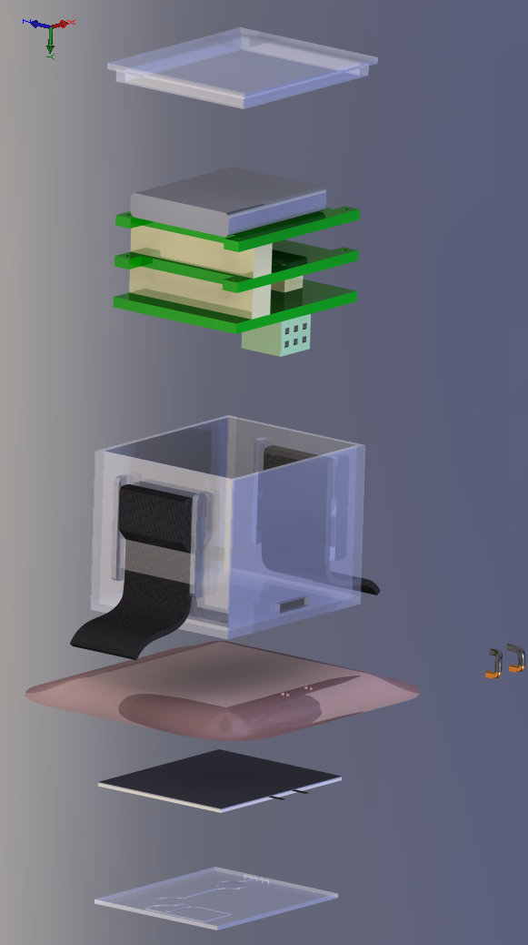
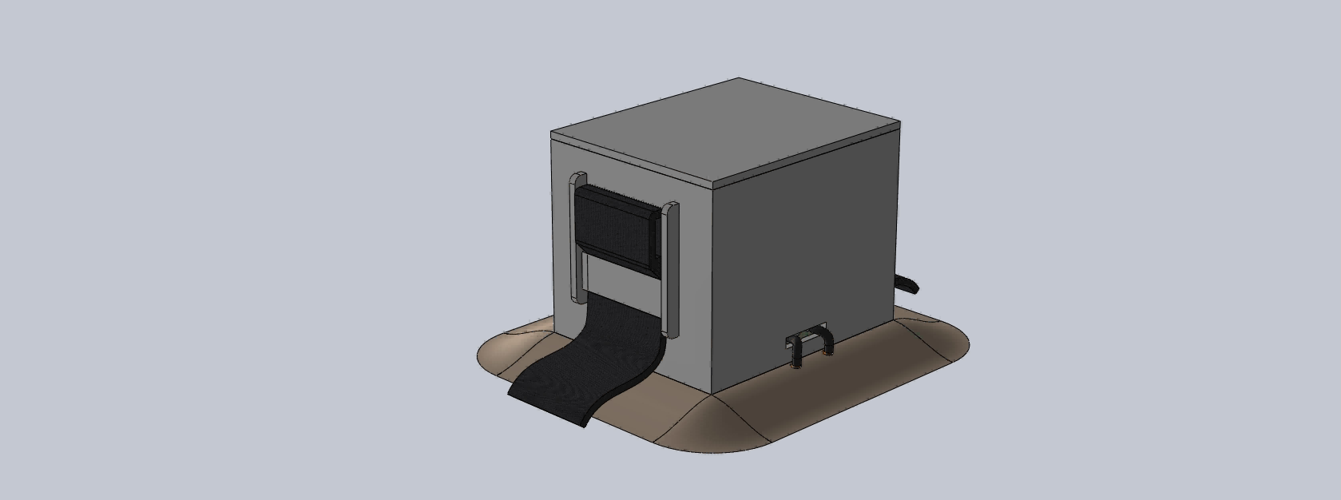
Wearable pH Sensor –Layers
Mote
Mote Casing
Patch
pH ISE & RE
Microfluidics
17

Slide 15
Acknowledgements
Dr. Salzitsa Anastasova, Dr. Aleksandar Radu,
Dr. Ulriika Mattinen,
Prof. Johan Bobacka
Prof. Dermot Diamond
Dr. Fiachra Collins, postdoc
Giusy Matzeu, PhD student
Javier Torres, Tyndall
18

Slide 16














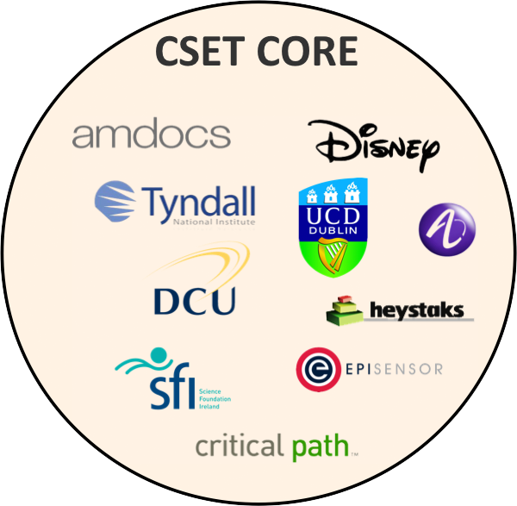
















































CLARITY Centre & Ecosystem
INDUSTRY COLLABORATORS
SOCIAL/AGENCY COLLABORATORS
SOCIAL/AGENCY COLLABORATORS
INDUSTRY COLLABORATORS
CSET CORE
INDUSTRY COLLABORATORS
SOCIAL/AGENCY COLLABORATORS
16
19

Slide 17
Thank You for Attention
20

Slide 18
pH ISEs – Role of SPE Design
A comparison between 1° calibration for (Ag+C) SPE & C (Batch II) SPE
(Ag+C) SPE
C SPE
12

